Slide 1
Żywe języki programowania
Living it up with a Live Programming Language
Sean McDirmid
Ecole Polytechnique Fédérale de Lausanne (EPFL)
sean.mcdirmid@epfl.ch
Notes:
A dynamic language improves programmer productivity through flexible typing, a focus on high-level programming, and by streamlining the edit-compile-debug cycle. Live languages go beyond dynamic languages with more programmer-centric features. A live language supports live programming that provides programmers with responsive and continuous feedback about how their edits affect program execution. A live language is also based on declarative programming constructs such as rules or data-flow connections so that programmers can write less code. A live language should also provide programmers with responsive semantic feedback to enable time-saving services such as code completion. This paper describes the design a textual live language known as SuperGlue. SuperGlue is based on reactive values known as signals that are supported with declarative data-flow connections and dynamic inheritance. Through signals and dynamic inheritance, SuperGlue supports live programming, declarative programming, and responsive semantic feedback. We demonstrate live programming in SuperGlue with a working prototype.

Slide 2
Agenda
Geneza
SuperGlue
Dodatkowe techniki
Szczegóły realizacji i implementacja
Przykład - PacMan

Slide 3
Dynamiczne języki programowania
edycja
kompi-lacja
debu-gowa-nie
Programowanie wysokopoziomowe
Dynamiczne typowanie
Spadek wydajności
Lisp
Smalltalk
Erling

Slide 4
Programowanie na żywo
Natychmiastowe efekty zmian
w kodzie
Konstrukcje deklaratywne
- mniej kodu
Dopełnianie kodu
i podpowiedzi
Często oparte
o metody wizualne

Slide 5
Języki wizualne
Dla „zwykłych użytkowników”
Komponenty – model deklaratywny
Problemy z graficzną reprezentacją większych programów
Excel, Forms/3, Fabrik, LabVIEW
Apple Quartz Composer: graf połączeń dźwiękowych
Połączenie cech wizualnych z tekstowymi

Slide 6
SUperGlue
Tekstowy, żywy język programowania

Slide 7
SuperGlue
Sygnały
i komponenty
Dynamiczne dziedzi-czenie
Graf przepływu danych
+
OOP
Dane zmienne w czasie
Sygnały dynamicznie dziedziczą po klasach

Slide 8
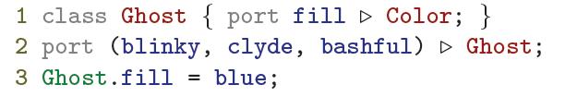
Przykład początkowy
Notes:
As an opening example, consider the following SuperGlue
code that defines the Ghost class, three ghost signals,
and connects the fill color of all ghost signals.
The first line of this code defines a Ghost class with a member
fill signal that extends the Color class.
The second line defines three signals, blinky, clyde, and bashful, which
extend the Ghost class.
The third line is a rule that connects the fill signal of all ghosts, including blinky, clyde, and bashful, to the color blue.
When used in expressions, class identifiers are variable that quantify over all signals that extend the identified class.
Unlike imperative assignments, connection rules have
declarative meaning that is unrelated to statement execution
order; e.g., on line three, blue is continuously connected to
rather than discretely assigned to the ghost’s fill color.

Slide 9
Sygnały
Wartości w grafie przepływu danych, które ułatwiają komunikację pomiędzy komponentami.
Są to obiekty dziedziczące po klasach, połączone z innymi sygnałami i zawierające sygnały zdefiniowane w ich nadrzędnych klasach.
Definiuje się je jako elementy klasy używając słowa kluczowego port

Slide 10
Klasy
Definiują zachowanie
Nie są wartościami i mogą być rozszerzone jedynie przez sygnały
Definiowane w najwyższej warstwie programu lub jako elementy inncyh klasy z wykorzystaniem słowa kluczowego class

Slide 11
Połączenia
Definiują zależność pomiędzy sygnałami, dzięki czemu ich wartość jest jednakowa
Są regułami podobnymi do prostych, jednokierunkowych ograniczeń.
Określany przy użyciu operatora =

Slide 12
Rozszerzenia (extensions)
Sprawiają, że sygnały rozszerzają klasy
Reguły wycelowane w sygnały poza ich definicją
Definiowane z wykorzystaniem operatora / „:”

Slide 13
Warunki (conditions)
Określają kiedy reguły połączeń i rozszerzeń mogą być zastosowane.
Odpytują istniejące połączenia i rozszerzenia za pomocą tych samych operatorów (= i ), których używa się do ich stworzenia
Tworzeone przez konstrukcje if otaczające reguły połączeń i rozszerzeń

Slide 14
Cel: uproszczony PacMan
Gracz steruje PacManem
za pomocą strzałek na klawiaturze
Komputer kontroluje duchy
Po dotknięciu ducha, PacMan w prawy górny róg
Kulka mocy na środku ektranu.

Slide 15
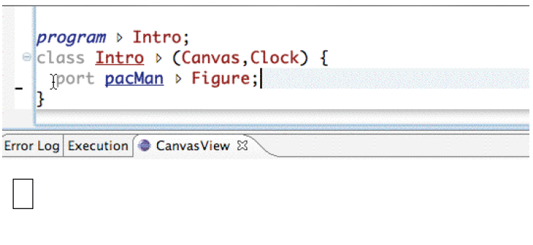
Rysunek (1/4)
Notes:
The programmer types “port pacMan . Figure” to define
a pacMan signal that extends the game’s Figure class
so pacMan is drawn on the game’s canvas. Because a
shape for pacMan has not been specified, it is drawn by
default as a rectangle.

Slide 16
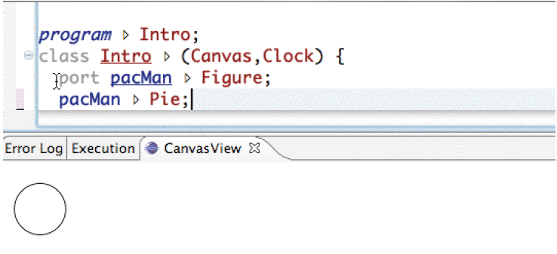
Rysunek (2/4)
Notes:
The programmer types the extension “pacMan . Pie,”
which causes pacMan to extend the Pie class and be
drawn as a circle. The shape of pacMan is updated on
screen as soon as the programmer types the “e” in Pie.

Slide 17
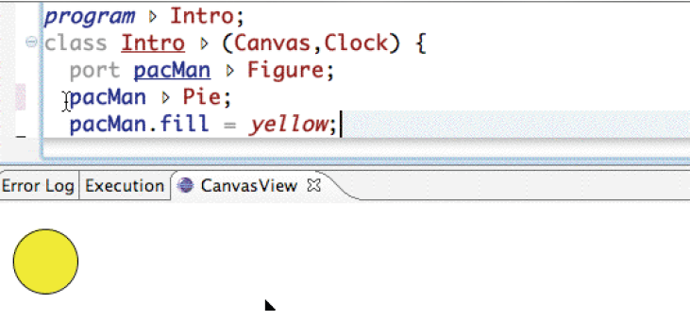
Rysunek (3/4)
Notes:
The programmer types the connection “pacMan.fill =
yellow,” causing this circle to be immediately colored
yellow. Through type inference, code completion can
complete typing for .fill in pacMan.

Slide 18
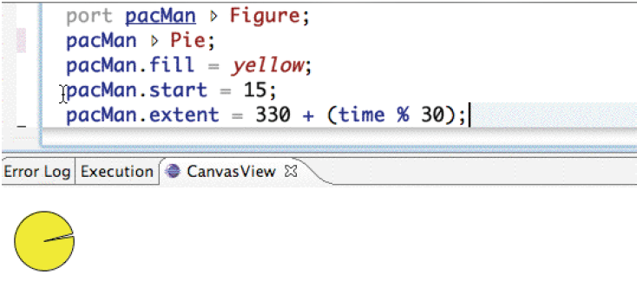
Rysunek (4/4)
Notes:
The programmer types “pacMan.extent = 330.” As the
programmer types each character in “330,” pacMan’s appears
respectively as a 357, 327, and finally a 30 degree
slice. The programmer than finishes this line with
“+ (time % 30),” which causes pacMan’s mouth to close
continuously in a 30 degree motion.

Slide 19
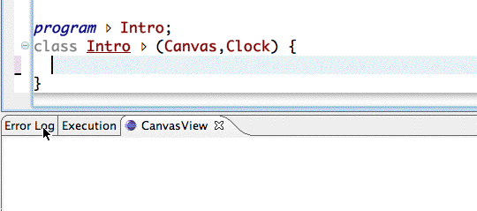
Rysunek - animacja

Slide 20
Dodatkowe techniki

Slide 21
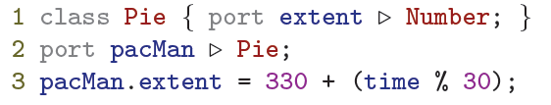
Stany stałe i zmienne traktowane jednakowo
Notes:
Graf przepływu danych jest reaktywny. W ten sam sposób są traktowane stałe i zmienne stany.
The last line of this code connects pacMan’s extent signal
to an expression that continuously increases from 330 until
360 degrees, causing pacMan’s mouth to shut continuously ina 30 degree motion. Such behavior occurs because the time
signal is a periodically incrementing number; e.g., it is connected
to 1042 and, after ten milliseconds, it is re-connected
to 1043.

Slide 22
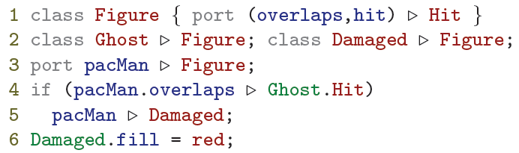
Dynamiczne dziedziczenie
Notes:
For the duration that pacMan overlaps with some figure,
pacMan’s overlaps signal is bound to the hit signal of this
figure. The condition on line four is then only true for durations
where the figure that pacMan overlaps with is a ghost.
During these durations, pacMan extends the Damaged class,
inheriting all the behavior of this class and being subject to
rules that target signals of this class. For example, the connection
of red to a damaged figure’s fill color would apply
to pacMan while it overlaps with a ghost. As soon as pacMan
no longer overlaps with a ghost, it unextends the Damaged
class and the special damaged behavior no longer applies.

Slide 23
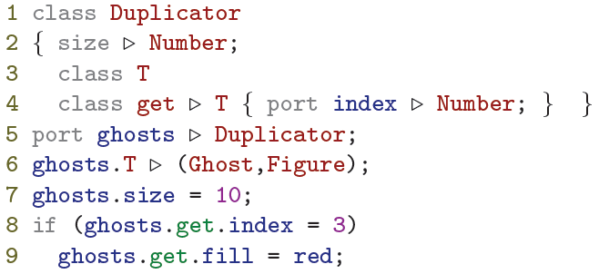
Typowanie zależne
Notes:
Consider this code that creates ten ghosts.
On line nine, the inferred
type of ghosts.get contains the following classes:
ghosts.get by definition, Duplicator.get because the
ghosts prefix extends Duplicator on line five, ghosts.T
because of the extension on line four and by a binding of
Duplicator to ghosts on line five, Duplicator.T by line
five again, and finally, Ghost and Figure by the extension on
line six. On line nine, the fill signal can be accessed and
connected because ghosts.get signals extend Figure.

Slide 24
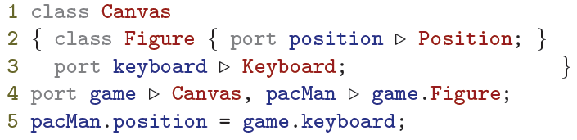


Mediatory typów
Notes:
Independently-developed or differently-purposed components
will often not agree on the types of their non-primitive
signals. For this reason, SuperGlue permits connections between
type-incompatible signals where additional rules can
define compatibility.
In this code the pacMan’s position is connected to a keyboard.
The signal types involved in the connection on line five are
incompatible: the type of pacMan.position contains only
the Position class while the type of game.keyboard contains
only the Keyboard class. The programmer intends the
position of pacMan to be controlled by the keyboard. Such
intent can be realized with code that defines what it means
for a signal to extend the otherwise unrelated Position and
Keyboard classes.

Slide 25
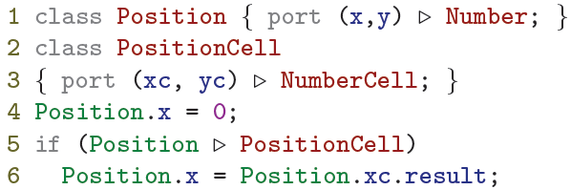
Wnioskowanie typów
Notes:
On line four, the inferred type of Position includes
only the Position class because the type of a class identifier
always contains itself. On line six, Position’s inferred
type also contains the PositionCell class because of the
surrounding extension-querying condition on line five. As
a result, the connection on line six, which targets the type
(Position,PositionCell), overrides the connection on line
four, which targets the type (Position). Because Position’s
inferred type on line six contains the PositionCell class, the
member signal xc can be accessed through Position and is
listed by code completion.

Slide 26
Wnioskowanie typów w Ide

Slide 27
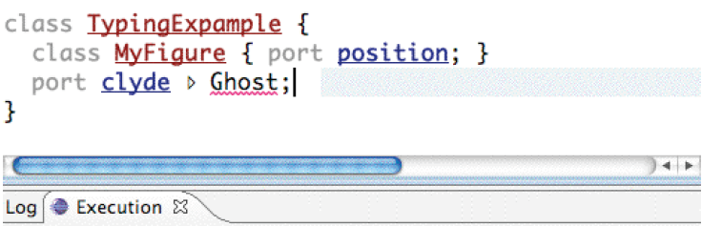
Wnioskowanie typów w Ide (1/4)
Notes:
The programmer types port clyde . Ghost, where Ghost
is underlined with red jaggies because it cannot be resolved
to a symbol.

Slide 28
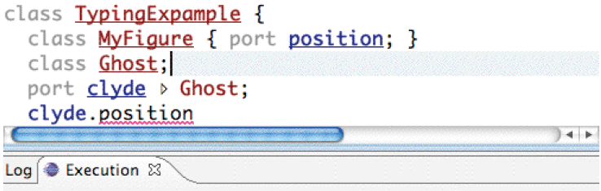
Wnioskowanie typów w Ide (2/4)
Notes:
As soon as the programmer defines the Ghost class, the
reference to Ghost in clyde’s definition becomes valid.
The programmer then tries to access clyde’s position
signal, which is underlined with red jaggies because
position is not a member of clyde.

Slide 29
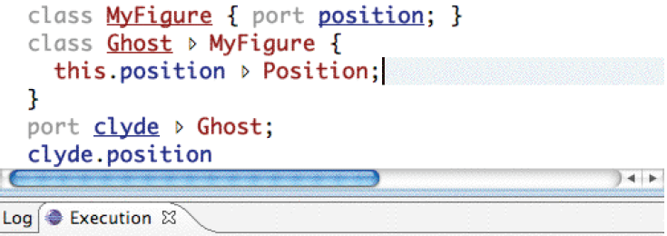
Wnioskowanie typów w Ide (3/4)
Notes:
As soon as the programmer causes the Ghost class to extend
the MyFigure class, the access to clyde’s position
signal becomes valid.

Slide 30
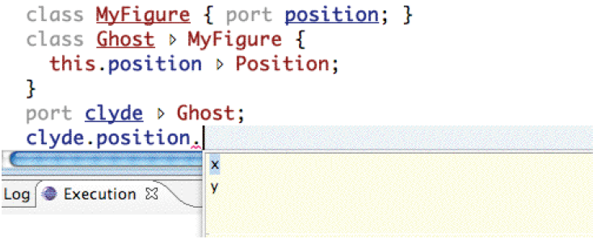
Wnioskowanie typów w Ide (4/4)
Notes:
Because the position signal in all Ghost signals extends
the Position class, the x and y position signals show up
in code completion on clyde’s position signal.

Slide 31
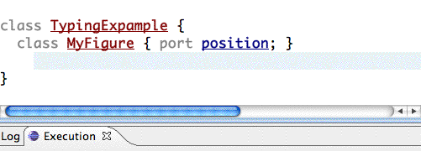
Wnioskowanie typów w Ide

Slide 32
Realizacja języka

Slide 33
przetwarzanie kodu
skanowanie
parsowanie
wnioskowanie typów
wykonanie
Parsowanie
z pierwszeństwem
Damage and repair
Zmiany w kodzie
Zmiany stanu wywołane sygnałem
Zmiana grafu przepływu danych

Slide 34
Błędy czasu wykonania
niejednoznacznie połączone sygnaly
niepołączone sygnały prymitywne
specyficzne błędy (np. dzielenie przez 0)
błędy reportowane jako wartości sygnałów w osobnym oknie
program kontynuuje
z wartościami domyślnymi

Slide 35
implementacja

Slide 36

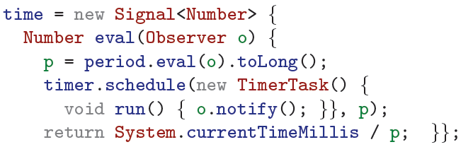
Sygnały
Notes:
A signal provider implements the Signal interface’s eval
method to provide a signal’s current value and ensure that an
Observer is notified when that value changes.
The SuperGlue runtime produces and consumes signals
according to the Signal Java interfaces based on the the
rules of a SuperGlue program. For example, the connection
period = 100 causes the SuperGlue runtime to create
a Java Signal object that returns 100 when its eval method
is called. As we discuss in Section 3, edits to code will notify
observers of the signals derived from the edited code;
e.g., when the 100 token is changed through editing, the SuperGlue
runtime will notify all observers that the period’s
eval method was called with. It is through the implementation
and routing of signals via declarative rules that Super-
Glue adds its value to the program; i.e., SuperGlue acts as a
middle man between components that do the real work.
The time signal’s eval method schedules a timer task to
notify the caller that the time has changed, which occurs
in period milliseconds. A signal consumer calls the Signal
interface’s eval method to access a signal’s value, and can
provide an observer so that it is notified of changes in the
value. For example, the time signal calls the eval method
on the clock’s period signal to obtain the clock’s period.
The time signal’s implementation passes its called observer
directly into the period signal. As a result, when a clock’s
period signal change, its time clients are notified directly.

Slide 37
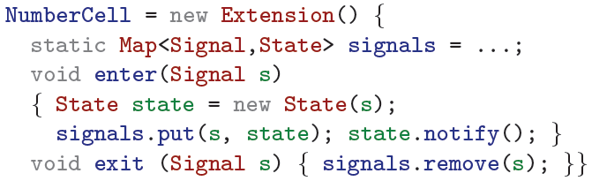
Rozszerzenia
Notes:
The enter and exit methods of a class extension are called
when a signal starts or stops extending a class, which occurs
when the signal is created, destroyed, or when the guard
of an extension changes. The enter and exit methods of
a class extension are responsible for managing the signal’s
state with respect to the class.

Slide 38
Pacman
Dokończenie gry

Slide 39
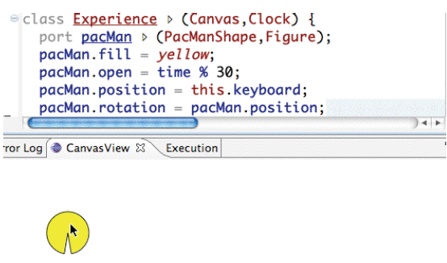
PacMan (1/4)
Notes:
pacMan’s position is bound to the keyboard of the canvas
it is displayed in. So that pacMan’s orientation corresponds
to the direction it is moving in, its rotation
signal is bound to its position. pacMan then moves as
expected in a video game.

Slide 40
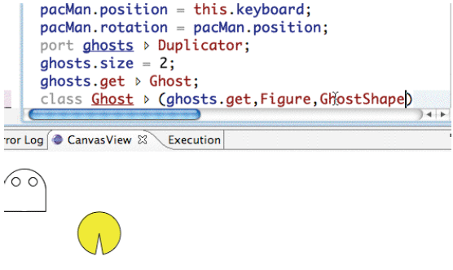
PACMAN (2/4)
Notes:
Ghosts for the game are created by defining a ghosts
signal that extends the Duplicator class. Initially two
ghosts are created, which are drawn as ghost shapes on
the canvas by extending the Figure and Ghost classes.
Because both ghosts occupy the same default position,
only one ghost is visible.

Slide 41
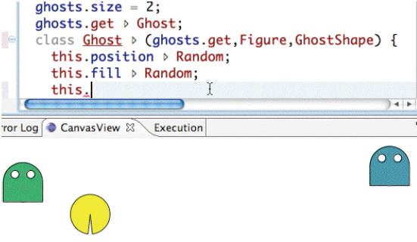
PACMAN (3/4)
Notes:
The Ghost class is defined as an open extension to the
ghosts.get class. In this class, the position and fill
signals of each ghost extend the Random class, causing
each ghost to have a random color and motion.

Slide 42
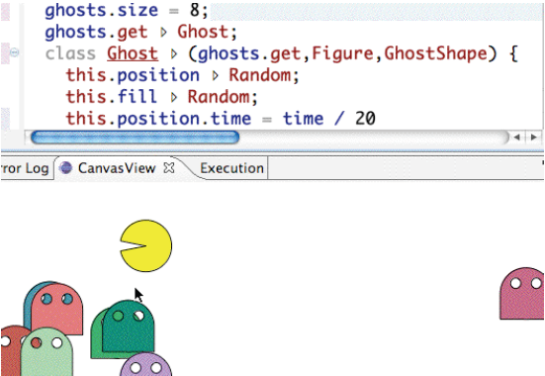
PACMAN (4/4)
Notes:
Finally, the number of ghosts is changed from two to
eight, causing six more ghosts to appear after around
three seconds of edit latency.

Slide 43
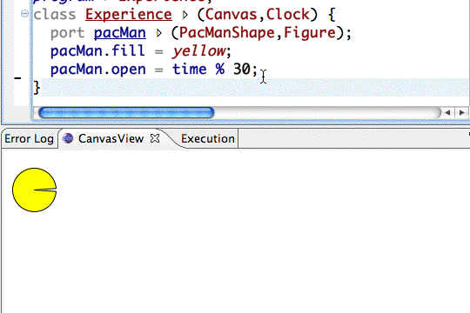
pacman

Slide 44
Dziękuję

