Slide 1
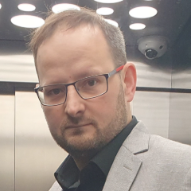
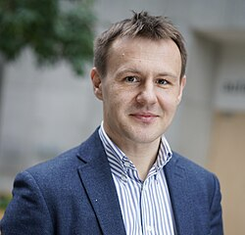
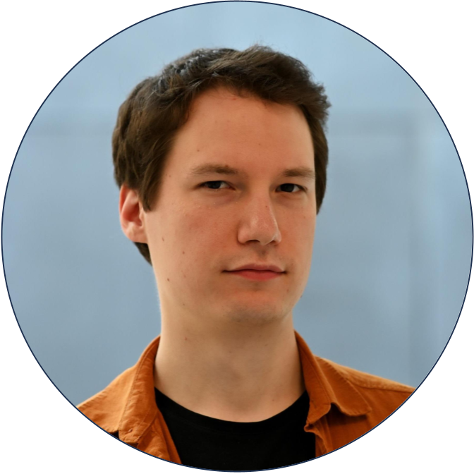
Participatory Budgeting Rules: The Bad, the Good, and the Better.
Method of Equal Shares with Bounded Overspending.
G. Papasotiropoulos Z. Pishbin O. Skibski P. Skowron T. Wąs

Slide 2
What is Participatory Budgeting (PB)?
Letting citizens have a say in how the government spends money
City council sets the budget
Residents submit project proposals
Officials review proposals: check scope, suggest changes, merge, or shortlist
Residents (often without strict age restrictions) vote on the projects
More than 150 initiatives with budgets of at least 100,000€; [wikipedia.org/wiki/List_of_participatory_budgeting_votes] thousands more examples worldwide

Slide 3
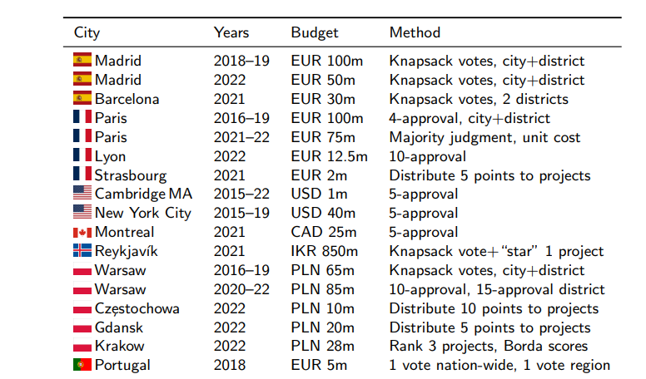
Some PB processes (€ 1m-100m)
First introduced in 2011
Mandatory in major cities since 2019

Slide 4
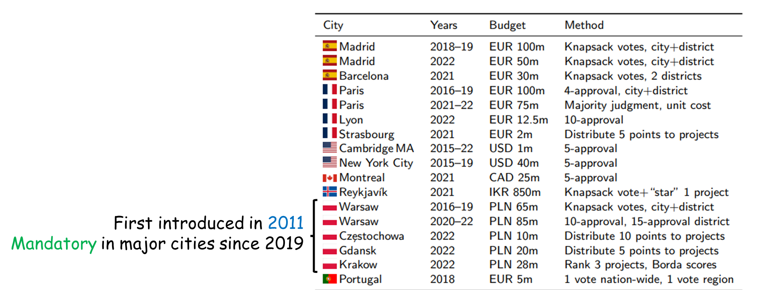
Some PB processes (€ 1m-100m)
No way there's no PB in Greece — it's the birthplace of democracy!
Why did you forget to include it?

Slide 5
The mathy slide

Slide 6
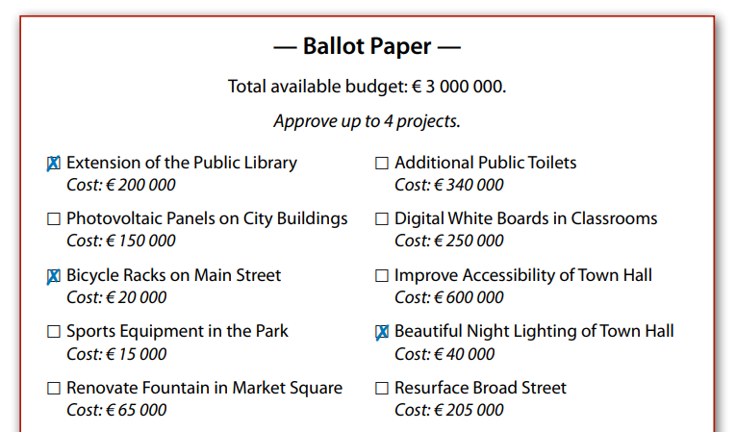
Preferences are mostly expressed by approval ballots.
The voting methods will be discussed work for other voting formats as well (e.g. scores)

Slide 7
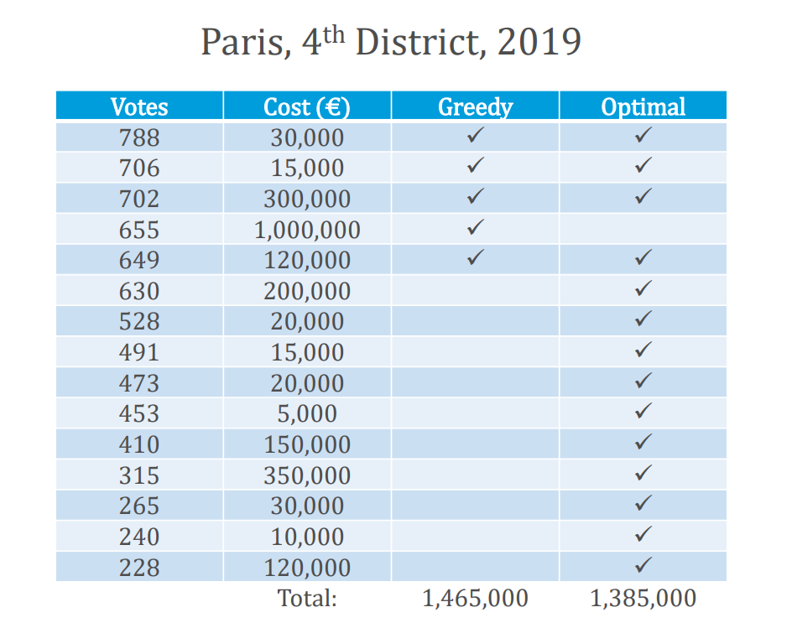
How is it currently done?
Elections? Easy peasy. Just pick the projects with the most support.
“optimal” solution: significantly higher support.
The “optimal” solution is also cheaper.
Votes-per-cost criterion? unfair even with projects of the same cost

Slide 8
cost: 10k 10k 10k 10k 10k 10k
votes: 310k 310k 310k 290k 290k 290k
30k
600k

Slide 9
cost: 10k 10k 10k 10k 10k 10k
votes: 310k 310k 310k 290k 290k 290k
30k
600k

Slide 10
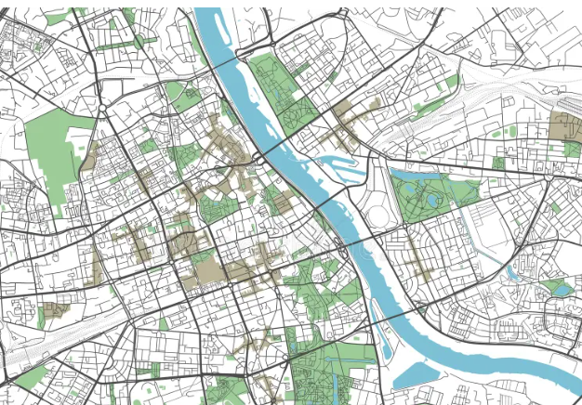
cost: 10k 10k 10k 10k 10k 10k
District B
~50% of the residents
votes: 310k 310k 310k 290k 290k 290k
30k
District A
~50% of the residents
600k

Slide 11
just split the budget across districts (based on population), and run separate elections in each.

Slide 12
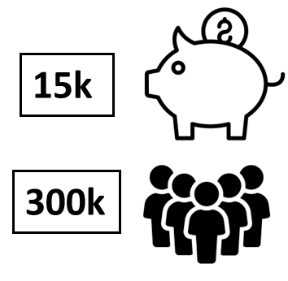
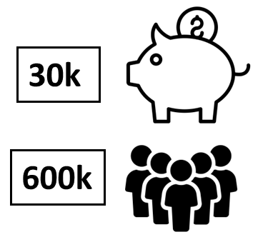
District B
~50% of the residents
District A
~50% of the residents
just split the budget across districts (based on population), and run separate elections in each.

Slide 13
A voter might be happy with a park — anywhere, really.
What about voters who live near district borders?
Some projects, like a bike road, could cross multiple districts.
"I want a parking lot near Archimedes, a park by AUEB, pedestrian zones in Kipseli, and trees in Exarcheia Square!"
A district with low-support projects might still be forced to fund them.
 | Project | Votes | Cost
Krakow 2021 | Green areas in neighborhood X | 3177 | 300k
 | Park near neighborhood X | 1347 | 550k
Warsaw 2020 | Plants at neighborhood Y (citywide project) | 5623 | 293k
 | Lamps and plants in a street of neighborhood Y | 785 | 310k
just split the budget across districts (based on population), and run separate elections in each.

Slide 14
Fairness w.r.t. projects’ categories

Slide 15
Fairness w.r.t. projects’ categories
cost: 10k 10k 10k 10k 10k 10k 10k 10k
votes: 60k 30k
30k
90k

Slide 16
Fairness w.r.t. projects’ categories
cost: 10k 10k 10k 10k 10k 10k 10k 10k
votes: 60k 30k
30k
90k

Slide 17
Fairness w.r.t. projects’ categories
cost: 10k 10k 10k 10k 10k 10k 10k 10k
votes: 60k 30k
1/3 of the population with common preferences should decide on 1/3 of the budget, i.e. 10k.
Here, 2/3 of the population control the whole budget
(Krakow, 2020: 8.5% of the voters could have controlled the entire budget.)
30k
90k

Slide 18
Proportionality: If a group makes up x% of the population and shares similar preferences, they should elect projects they support costing at least x% of the total budget.
votes: 60% 25% 15%
60% of the budget to bike-lanes
25% of the budget to parks
15% of the budget to playgrounds
class of axioms:
JR ← PJR ← EJR

Slide 19
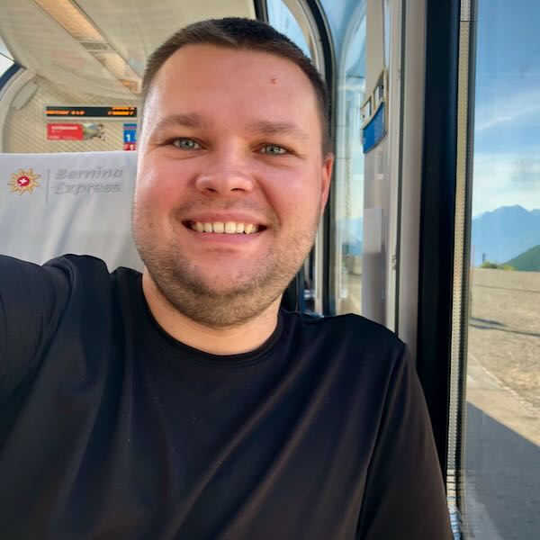
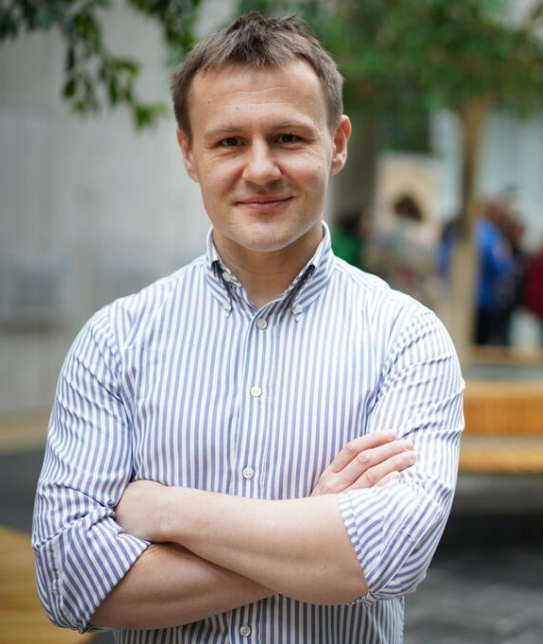
Proportionality: If a group makes up x% of the population and shares similar preferences, they should elect projects they support costing at least x% of the total budget.
Method of Equal Shares (MES). 2019
D. Peters
CNRS-Lamsade
P. Skowron
University of Warsaw
Rule X
MES satisfies EJR when all projects have the same cost
MES satisfies a very close approximation of EJR in general
No polynomial rule satisfies EJR

Slide 20
Method of Equal Shares (MES).
Split the budget equally among voters.
Look for a project its supporters can afford.
If there are several, choose the one whose cost can be split most thinly: each pays cost/ρ or less, maximize ρ.
Fund the project, split the cost as equally as possible among its supporters, find next affordable project.

Slide 21
Project | cost
Athletic gym 💪 | 300
Basketball courts 🏀 | 400
Cycling paths 🚲 | 300
Dinosaur park 🦕 | 240
Events for kids 🎪 | 170
Family picnic 🧺 | 100
Method of Equal Shares (MES).
1
2
3
4
5
6
7
8
9
10
Split the budget equally among voters.
Look for a project its supporters can afford.
If there are several, choose the one whose cost can be split most thinly: each pays cost/ρ or less, maximize ρ.
1k
Fund the project, split the cost as equally as possible among its supporters, find next affordable project.

Slide 22
Project | cost
Athletic gym 💪 | 300
Basketball courts 🏀 | 400
Cycling paths 🚲 | 300
Dinosaur park 🦕 | 240
Events for kids 🎪 | 170
Family picnic 🧺 | 100
Method of Equal Shares (MES).
1
2
3
4
5
6
7
8
9
10
Split the budget equally among voters.
Look for a project its supporters can afford.
If there are several, choose the one whose cost can be split most thinly: each pays cost/ρ or less, maximize ρ.
1k
100
100
100
100
100
100
100
100
100
100
100
Fund the project, split the cost as equally as possible among its supporters, find next affordable project.
budgets
0

Slide 23
Project | cost |  |  |  |  |  |  |  |  |  |  | Each supporter pays at most
A 💪 | 300
B 🏀 | 400
C 🚲 | 300
D 🦕 | 240
E 🎪 | 170
F 🧺 | 100
Method of Equal Shares (MES).
1
2
3
4
5
6
7
8
9
10
Split the budget equally among voters.
Look for a project its supporters can afford.
If there are several, choose the one whose cost can be split most thinly: each pays cost/ρ or less, maximize ρ.
Max denominator
100
100
100
100
100
100
100
100
100
100
100
Fund the project, split the cost as equally as possible among its supporters, find next affordable project.
budgets
0

Slide 24
Project | cost |  |  |  |  |  |  |  |  |  |  | Each supporter pays at most
A 💪 | 300 |  |  |  |  |  |  |  |  |  |  | cost/6
B 🏀 | 400
C 🚲 | 300
D 🦕 | 240
E 🎪 | 170
F 🧺 | 100
Method of Equal Shares (MES).
1
2
3
4
5
6
7
8
9
10
Split the budget equally among voters.
Look for a project its supporters can afford.
If there are several, choose the one whose cost can be split most thinly: each pays cost/ρ or less, maximize ρ.
Max denominator
100
100
100
100
100
100
100
100
100
100
100
Fund the project, split the cost as equally as possible among its supporters, find next affordable project.
budgets
0

Slide 25
Project | cost |  |  |  |  |  |  |  |  |  |  | Each supporter pays at most
A 💪 | 300 |  |  |  |  |  |  |  |  |  |  | cost/6
B 🏀 | 400 |  |  |  |  |  |  |  |  |  |  | cost/5
C 🚲 | 300 |  |  |  |  |  |  |  |  |  |  | cost/5
D 🦕 | 240 |  |  |  |  |  |  |  |  |  |  | cost/4
E 🎪 | 170 |  |  |  |  |  |  |  |  |  |  | cost/4
F 🧺 | 100 |  |  |  |  |  |  |  |  |  |  | cost/3
Method of Equal Shares (MES).
1
2
3
4
5
6
7
8
9
10
Split the budget equally among voters.
Look for a project its supporters can afford.
If there are several, choose the one whose cost can be split most thinly: each pays cost/ρ or less, maximize ρ.
Max denominator
100
100
100
100
100
100
100
100
100
100
100
Fund the project, split the cost as equally as possible among its supporters, find next affordable project.
budgets
0

Slide 26
Project | cost |  |  |  |  |  |  |  |  |  |  | Each supporter pays at most
A 💪 | 300 |  |  |  |  |  |  |  |  |  |  | cost/6
B 🏀 | 400 |  |  |  |  |  |  |  |  |  |  | cost/5
C 🚲 | 300 |  |  |  |  |  |  |  |  |  |  | cost/5
D 🦕 | 240 |  |  |  |  |  |  |  |  |  |  | cost/4
E 🎪 | 170 |  |  |  |  |  |  |  |  |  |  | cost/4
F 🧺 | 100 |  |  |  |  |  |  |  |  |  |  | cost/3
Method of Equal Shares (MES).
1
2
3
4
5
6
7
8
9
10
Split the budget equally among voters.
Look for a project its supporters can afford.
If there are several, choose the one whose cost can be split most thinly: each pays cost/ρ or less, maximize ρ.
Max denominator
100
100
100
100
100
100
100
100
100
100
100
Fund the project, split the cost as equally as possible among its supporters, find next affordable project.
budgets
0

Slide 27
Project | cost |  |  |  |  |  |  |  |  |  |  | Each supporter pays at most
A 💪 | 300 |  |  |  |  |  |  |  |  |  |  | cost/6
B 🏀 | 400 |  |  |  |  |  |  |  |  |  |  | cost/5
C 🚲 | 300 |  |  |  |  |  |  |  |  |  |  | cost/5
D 🦕 | 240 |  |  |  |  |  |  |  |  |  |  | cost/4
E 🎪 | 170 |  |  |  |  |  |  |  |  |  |  | cost/4
F 🧺 | 100 |  |  |  |  |  |  |  |  |  |  | cost/3
Method of Equal Shares (MES).
1
2
3
4
5
6
7
8
9
10
Split the budget equally among voters.
Look for a project its supporters can afford.
If there are several, choose the one whose cost can be split most thinly: each pays cost/ρ or less, maximize ρ.
Max denominator
100
100
100
100
100
100
100
100
100
100
100
Fund the project, split the cost as equally as possible among its supporters, find next affordable project.
budgets
50
50
50
50
50
50
0

Slide 28
Project | cost |  |  |  |  |  |  |  |  |  |  | Each supporter pays at most
A 💪 | 300 |  |  |  |  |  |  |  |  |  |  | cost/6
B 🏀 | 400 |  |  |  |  |  |  |  |  |  |  | cost/5
C 🚲 | 300 |  |  |  |  |  |  |  |  |  |  | cost/5
D 🦕 | 240 |  |  |  |  |  |  |  |  |  |  | cost/4
E 🎪 | 170 |  |  |  |  |  |  |  |  |  |  | cost/4
F 🧺 | 100 |  |  |  |  |  |  |  |  |  |  | cost/3
Method of Equal Shares (MES).
1
2
3
4
5
6
7
8
9
10
Split the budget equally among voters.
Look for a project its supporters can afford.
If there are several, choose the one whose cost can be split most thinly: each pays cost/ρ or less, maximize ρ.
Max denominator
100
100
100
100
100
Fund the project, split the cost as equally as possible among its supporters, find next affordable project.
budgets
50
50
50
50
50
50
0

Slide 29
Project | cost |  |  |  |  |  |  |  |  |  |  | Each supporter pays at most
A 💪 | 300
B 🏀 | 400
C 🚲 | 300 |  |  |  |  |  |  |  |  |  |  | cost/3
D 🦕 | 240 |  |  |  |  |  |  |  |  |  |  | cost/4
E 🎪 | 170 |  |  |  |  |  |  |  |  |  |  | cost/4
F 🧺 | 100 |  |  |  |  |  |  |  |  |  |  | cost/3
Method of Equal Shares (MES).
1
2
3
4
5
6
7
8
9
10
Split the budget equally among voters.
Look for a project its supporters can afford.
If there are several, choose the one whose cost can be split most thinly: each pays cost/ρ or less, maximize ρ.
Max denominator
100
100
100
100
100
Fund the project, split the cost as equally as possible among its supporters, find next affordable project.
budgets
50
50
50
50
50
50
0

Slide 30
Project | cost |  |  |  |  |  |  |  |  |  |  | Each supporter pays at most
A 💪 | 300
B 🏀 | 400
C 🚲 | 300 |  |  |  |  |  |  |  |  |  |  | cost/3
D 🦕 | 240 |  |  |  |  |  |  |  |  |  |  | cost/4
E 🎪 | 170 |  |  |  |  |  |  |  |  |  |  | cost/4
F 🧺 | 100 |  |  |  |  |  |  |  |  |  |  | cost/3
Method of Equal Shares (MES).
1
2
3
4
5
6
7
8
9
10
Split the budget equally among voters.
Look for a project its supporters can afford.
If there are several, choose the one whose cost can be split most thinly: each pays cost/ρ or less, maximize ρ.
Max denominator
100
100
100
100
100
Fund the project, split the cost as equally as possible among its supporters, find next affordable project.
budgets
50
50
50
50
50
50
0

Slide 31
Project | cost |  |  |  |  |  |  |  |  |  |  | Each supporter pays at most
A 💪 | 300
B 🏀 | 400
C 🚲 | 300 |  |  |  |  |  |  |  |  |  |  | cost/3
D 🦕 | 240 |  |  |  |  |  |  |  |  |  |  | cost/4
E 🎪 | 170 |  |  |  |  |  |  |  |  |  |  | cost/4
F 🧺 | 100 |  |  |  |  |  |  |  |  |  |  | cost/3
Method of Equal Shares (MES).
1
2
3
4
5
6
7
8
9
10
Split the budget equally among voters.
Look for a project its supporters can afford.
If there are several, choose the one whose cost can be split most thinly: each pays cost/ρ or less, maximize ρ.
Max denominator
100
100
100
100
100
Fund the project, split the cost as equally as possible among its supporters, find next affordable project.
budgets
60
60
60
60
50
50
50
50
50
50
0

Slide 32
Project | cost |  |  |  |  |  |  |  |  |  |  | Each supporter pays at most
A 💪 | 300
B 🏀 | 400
C 🚲 | 300
D 🦕 | 240
E 🎪 | 170 |  |  |  |  |  |  |  |  |  |  | cost/3.4
F 🧺 | 100 |  |  |  |  |  |  |  |  |  |  | cost/3
Method of Equal Shares (MES).
1
2
3
4
5
6
7
8
9
10
Split the budget equally among voters.
Look for a project its supporters can afford.
If there are several, choose the one whose cost can be split most thinly: each pays cost/ρ or less, maximize ρ.
Max denominator
100
Fund the project, split the cost as equally as possible among its supporters, find next affordable project.
budgets
50
50
50
50
50
50
40
40
40
40
0

Slide 33
Project | cost |  |  |  |  |  |  |  |  |  |  | Each supporter pays at most
A 💪 | 300
B 🏀 | 400
C 🚲 | 300
D 🦕 | 240
E 🎪 | 170 |  |  |  |  |  |  |  |  |  |  | cost/3.4
F 🧺 | 100 |  |  |  |  |  |  |  |  |  |  | cost/3
Method of Equal Shares (MES).
1
2
3
4
5
6
7
8
9
10
Split the budget equally among voters.
Look for a project its supporters can afford.
If there are several, choose the one whose cost can be split most thinly: each pays cost/ρ or less, maximize ρ.
Max denominator
100
Fund the project, split the cost as equally as possible among its supporters, find next affordable project.
budgets
50
50
50
50
50
50
40
40
40
40
0

Slide 34
Project | cost |  |  |  |  |  |  |  |  |  |  | Each supporter pays at most
A 💪 | 300
B 🏀 | 400
C 🚲 | 300
D 🦕 | 240
E 🎪 | 170
F 🧺 | 100
Method of Equal Shares (MES).
1
2
3
4
5
6
7
8
9
10
Split the budget equally among voters.
Look for a project its supporters can afford.
If there are several, choose the one whose cost can be split most thinly: each pays cost/ρ or less, maximize ρ.
Max denominator
100
Fund the project, split the cost as equally as possible among its supporters, find next affordable project.
budgets
50
50
50
50
50
40
0
0
0
0
0

Slide 35
🙂
🙂
🙂
🙂
🙂
🙂
🙂
🙂
🙂
Method of Equal Shares (MES).
Project | cost |  |  |  |  |  |  |  |  |  |  | Each supporter pays at most
A 💪 | 300
B 🏀 | 400
C 🚲 | 300
D 🦕 | 240
E 🎪 | 170
F 🧺 | 100
🙂
1
2
3
4
5
6
7
8
9
10
Split the budget equally among voters.
Look for a project its supporters can afford.
If there are several, choose the one whose cost can be split most thinly: each pays cost/ρ or less, maximize ρ.
Max denominator
100
Fund the project, split the cost as equally as possible among its supporters, find next affordable project.
budgets
50
50
50
50
50
40
0
0
0
0
0

Slide 36
Method of Equal Shares (MES).
Simple to understand and explain
Polynomial, can be used in PB no matter the scale
^{Fair (EJR etc)!}
Higher satisfaction for the least satisfied voters
Keeps the voting process the same
Split the budget equally among voters.
Look for a project its supporters can afford.
If there are several, choose the one whose cost can be split most thinly: each pays cost/ρ or less, maximize ρ.
normative properties
Fund the project, split the cost as equally as possible among its supporters, find next affordable project.
A vs. B: same cost, but A has more supporters → select A
A vs. B: same number of supporters, but A is cheaper → select A
A vs. B: same cost and supporters, but A’s supporters are less satisfied currently → select A

Slide 37
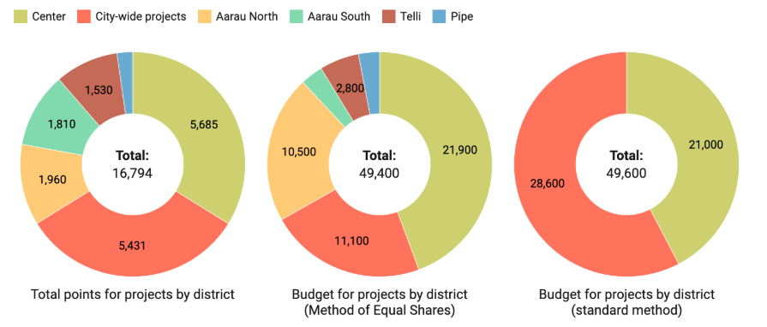
²⁰²³
^{50.000euro}
^{1800 voters}
^{Vote on at least 3 projects}
^{Elected 17 out of 33 projects}

Slide 38
²⁰²³
^{50.000euro}
^{1800 voters}
^{Vote on at least 3 projects}
^{Elected 17 out of 33 projects}

Slide 39
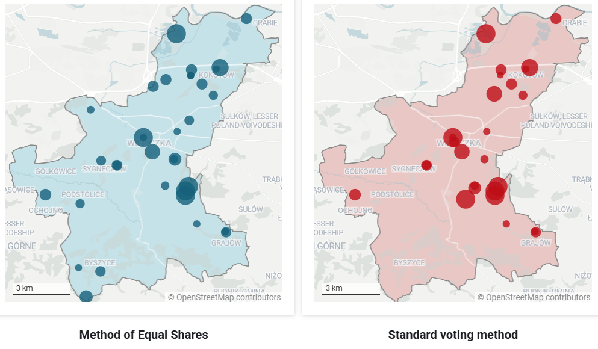
²⁰²³
^{250.000euro}
^{6500 voters}
^{Vote on at least 3 projects}
^{Elected 30 out of 64 projects} ^{all on ecology and environment}
82.2% with at least one approved ^{project, 72.4% under greedy!}

Slide 40
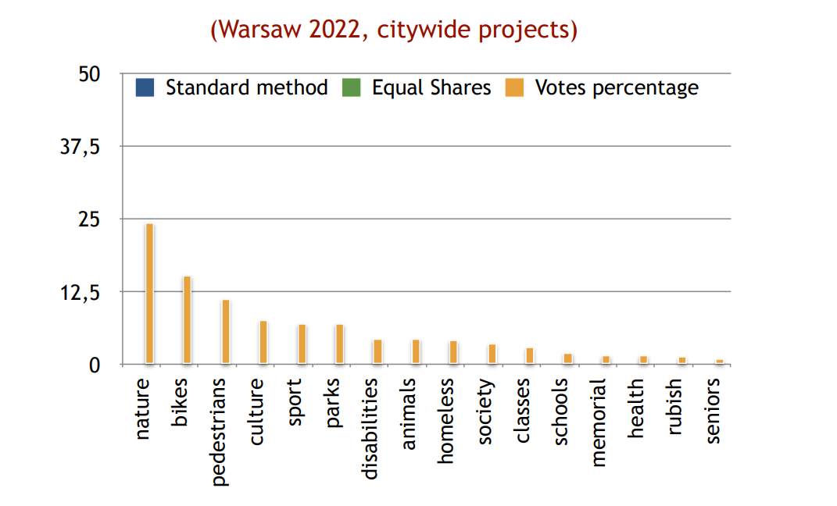
Fairness w.r.t. projects’ categories

Slide 41
Fairness w.r.t. projects’ categories

Slide 42
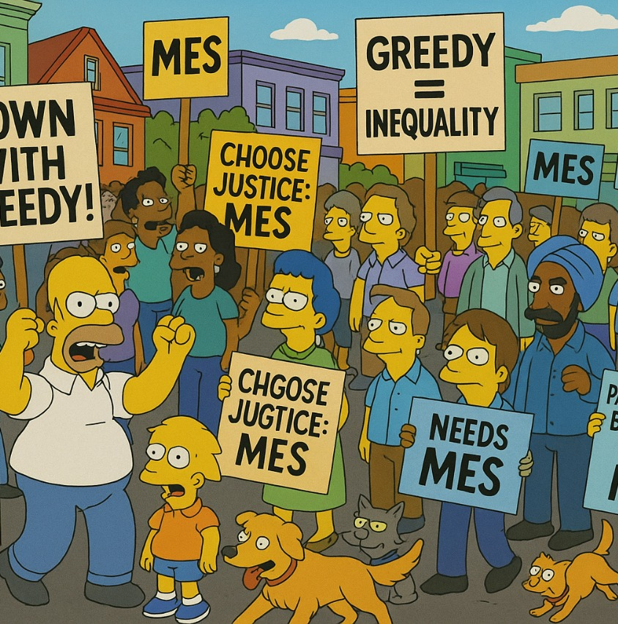
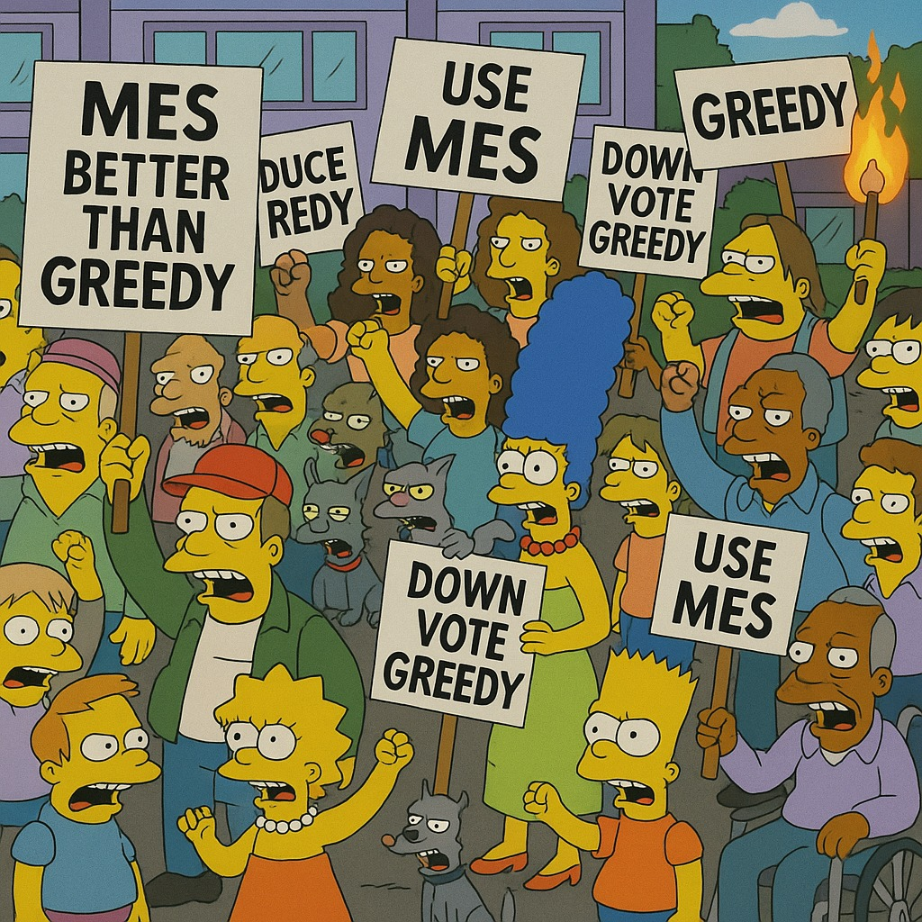

Slide 43
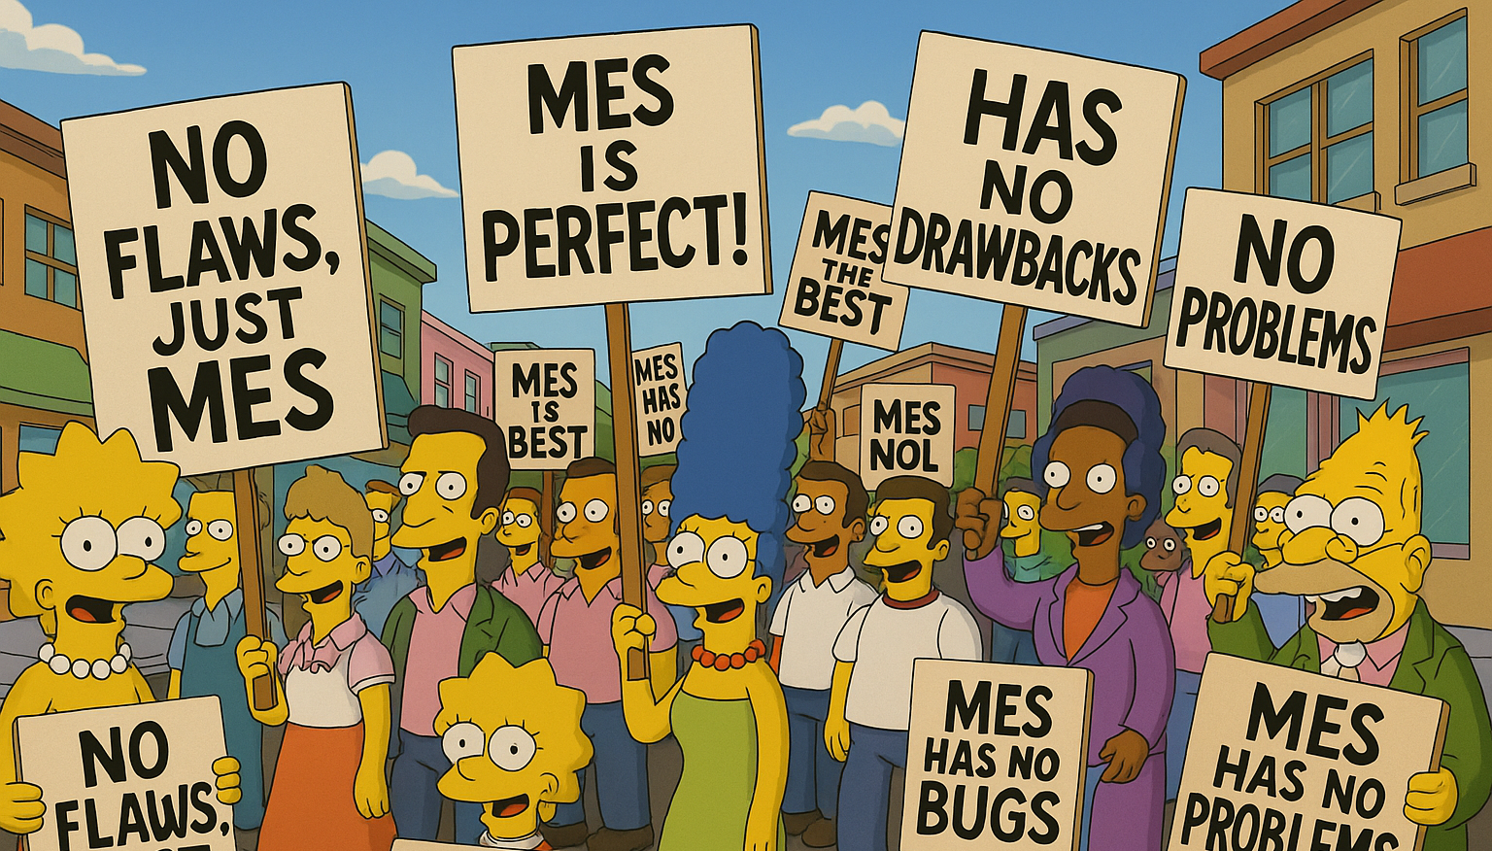

Slide 44
Problems of Equal Shares

Slide 45
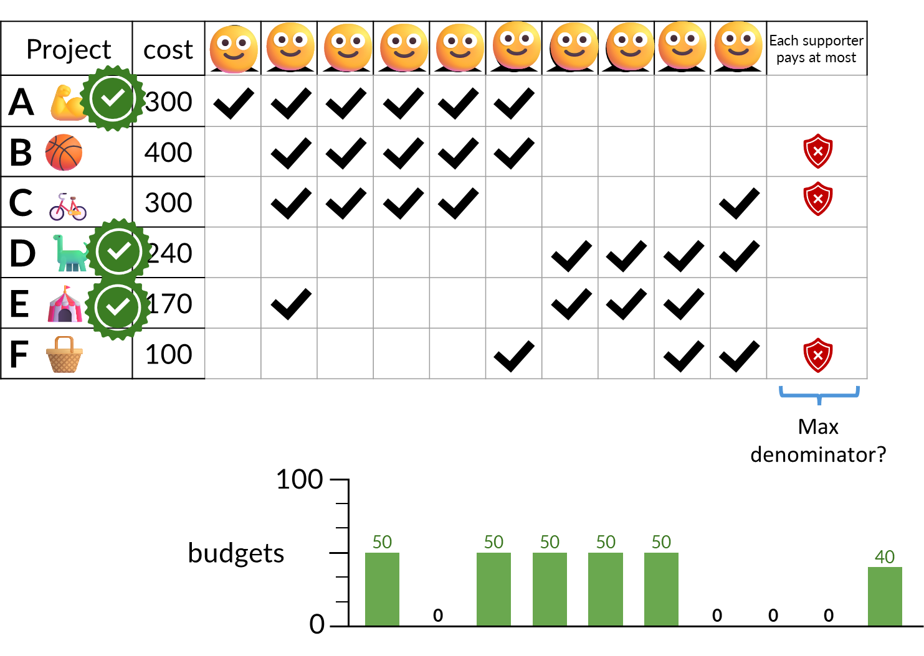
Underspending
Problems of Equal Shares
cost of elected projects=710, budget =1k but the supporters of F do not have funds to cover its cost
On average, on real instances, MES uses only 45% of the budget
Completion methods: heuristics with strong impact, high computational time

Slide 46
Underspending
Helenka Paradox (2020, Helenka, Zabrze, Poland)
Problems of Equal Shares
403 voters (97%)
11 voters (3%)
project | cost |  |  | … |  |  |  | … |  | selected
sport facilities 👟 | 310k |  |  | … |  |  |  | …
plant sculpture 🪴 | 6k |  |  | … |  |  |  | …
1
2
403
i
ii
xi
310k
414

Slide 47
Underspending
Helenka Paradox (2020, Helenka, Zabrze, Poland)
Problems of Equal Shares
403 voters (97%)
11 voters (3%)
project | cost |  |  | … |  |  |  | … |  | selected
sport facilities 👟 | 310k |  |  | … |  |  |  | …
plant sculpture 🪴 | 6k |  |  | … |  |  |  | …
😭
😭
😭
🙂
🙂
🙂
1
2
403
i
ii
xi
^{Not an isolated instance}
Result of JR—critique to proportionality!
310k
414
Comparison to greedy, pick best; upper bound on projects’ costs

Slide 48
Underspending
Helenka Paradox
Tail Utilities
Problems of Equal Shares
Related to non-approval ballots
^{Because of MES mechanics}

Slide 49
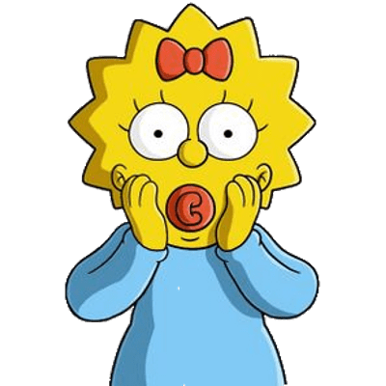
Underspending
Helenka Paradox
Tail Utilities
Problems of Equal Shares
Related to non-approval ballots
^{Because of MES mechanics}
Does BOS solve them all?

Slide 50
Bounded Overspending Eq. Shares (BOS)
Works like MES but lets voters overspend once if the affordable fraction of a project already provides high enough utility.

Slide 51
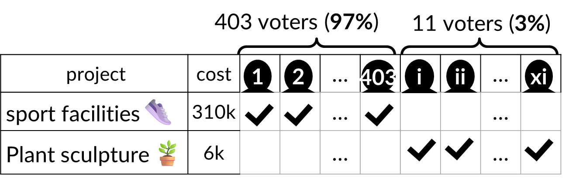
Bounded Overspending Eq. Shares (BOS)
Works like MES but lets voters overspend once if the affordable fraction of a project already provides high enough utility.
(2020, Helenka, Zabrze, Poland)
310k
414
750
budgets
0

Slide 52
Bounded Overspending Eq. Shares (BOS)
Works like MES but lets voters overspend once if the affordable fraction of a project already provides high enough utility.
We can’t buy the entire project.
We can afford only a 403/414 fraction, which gives each voter a utility of 403/414.
We split the cost equally, so each contributes 1/403.
Calculate: contribution / utility (instead of contribution)
We need to split the cost equally, so each contributes 1/11 (for a utility of 1).
310k
414
$$\frac{1/{403}}{{403}/{414}}≈ \frac{1}{400}$$
750
budgets
0

Slide 53
Bounded Overspending Eq. Shares (BOS)
Works like MES but lets voters overspend once if the affordable fraction of a project already provides high enough utility.
We can’t buy the entire project.
We can afford only a 403/414 fraction, which gives each voter a utility of 403/414.
We split the cost equally, so each contributes 1/403.
Calculate: contribution / utility (instead of contribution)
We need to split the cost equally, so each contributes 1/11 (for a utility of 1).
310k
414
$$\frac{1/{403}}{{403}/{414}}≈ \frac{1}{400}$$
750
budgets
Max denominator?
0

Slide 54
Bounded Overspending Eq. Shares (BOS)
Works like MES but lets voters overspend once if the affordable fraction of a project already provides high enough utility.
We can’t buy the entire project.
We can afford only a 403/414 fraction, which gives each voter a utility of 403/414.
We split the cost equally, so each contributes 1/403.
Calculate: contribution / utility (instead of contribution)
We need to split the cost equally, so each contributes 1/11 (for a utility of 1).
310k
414
$$\frac{1/{403}}{{403}/{414}}≈ \frac{1}{400}$$
750
budgets
Max denominator?
0
-20
Bounded Overspending

Slide 55
Bounded Overspending Eq. Shares (BOS)
Works like MES but lets voters overspend once if the affordable fraction of a project already provides high enough utility.
doesn’t satisfy EJR (and this is good)!
approximates EJR (and this is good as well)!
We also defined a variant of MES for the fractional setting which satisfies (the fractional analog of) EJR

Slide 56
PaBuLib Data Analysis
991 instances of PB elections

Slide 57
PaBuLib Data Analysis
991 instances of PB elections
Fraction of budget spent
1
0.94
0.75
0.5
0.25
0

Slide 58
PaBuLib Data Analysis
991 instances of PB elections
Fraction of budget spent
1
0.97
0.94
0.75
0.5
0.25
unfair
0
Util.

Slide 59
PaBuLib Data Analysis
991 instances of PB elections
Fraction of budget spent
1
0.97
0.75
0.5
0.45
0.25
unfair
EJR
0
Util.
Eq. Sh.

Slide 60
PaBuLib Data Analysis
991 instances of PB elections
Fraction of budget spent
1
0.97
0.94
0.94
0.75
0.5
0.45
0.25
unfair
EJR-approx
EJR
0
Util.
Eq. Sh.
BOS

Slide 61
PaBuLib Data Analysis
991 instances of PB elections
Fraction of instances with exhausted budget
Fraction of budget spent
1
1
0.97
0.94
0.94
0.75
0.75
0.5
0.45
0.5
0.25
unfair
0.25
EJR-approx
EJR
0
0
Util.
Eq. Sh.
BOS

Slide 62
PaBuLib Data Analysis
991 instances of PB elections
Fraction of instances with exhausted budget
Fraction of budget spent
1
1
0.97
1.00
0.94
0.94
0.75
0.75
0.5
0.45
0.5
0.25
unfair
0.25
unfair
EJR-approx
EJR
0
0
Util.
Eq. Sh.
BOS
Util.

Slide 63
PaBuLib Data Analysis
991 instances of PB elections
Fraction of instances with exhausted budget
Fraction of budget spent
1
1
0.97
1.00
0.94
0.94
0.75
0.75
0.5
0.45
0.5
0.25
unfair
0.25
unfair
EJR-approx
EJR
0.06
0
0
EJR
Util.
Eq. Sh.
BOS
Util.
Eq. Sh.

Slide 64
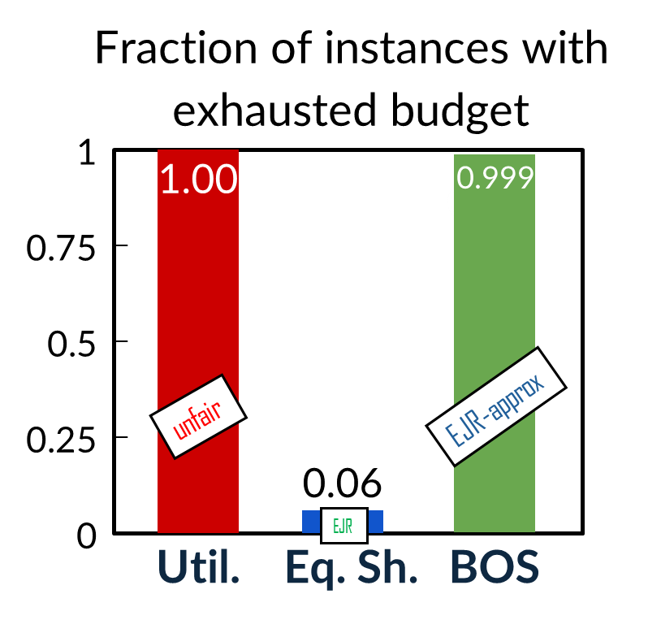
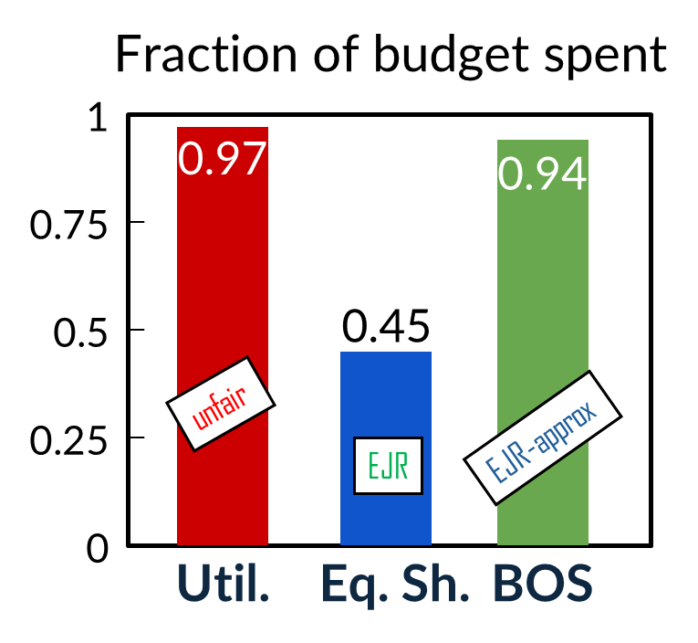
PaBuLib Data Analysis
991 instances of PB elections
Fraction of instances with exhausted budget
Fraction of budget spent
1
1
0.97
1.00
0.999
0.94
0.94
0.94
0.75
0.75
0.5
0.45
0.5
0.25
unfair
0.25
unfair
EJR-approx
EJR-approx
EJR
0.06
0
0
EJR
Util.
Eq. Sh.
BOS
Util.
Eq. Sh.
BOS

Slide 65
PaBuLib Data Analysis
991 instances of PB elections
1.00
0.95
0.90
Average Total Utility
0.85
0.80
1–8
9–16
17–28
29+
Number of Projects

Slide 66
PaBuLib Data Analysis
991 instances of PB elections
1.00
Utilitarian
0.95
Equal Shares
(with add1u)
0.90
Average Total Utility
0.85
0.80
1–8
9–16
17–28
29+
Number of Projects

Slide 67
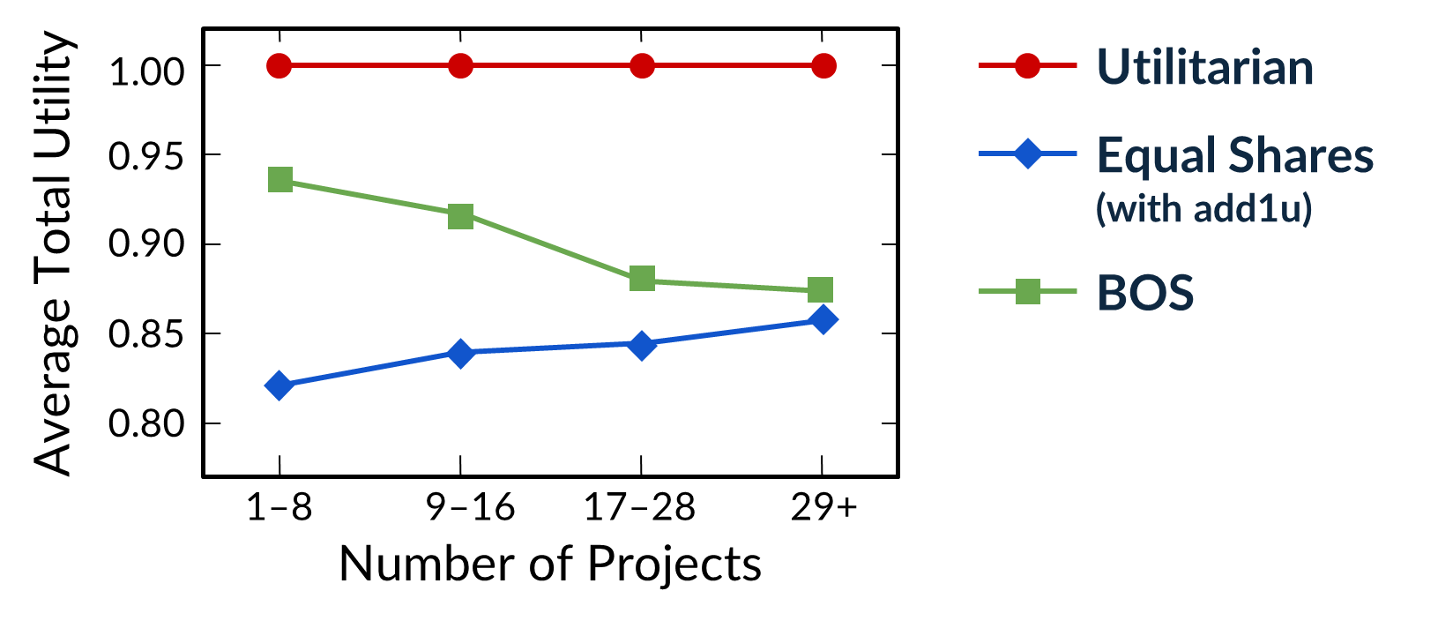
PaBuLib Data Analysis
991 instances of PB elections

Slide 68
PaBuLib Data Analysis
991 instances of PB elections
30%
25%
Exclusion Ratio
20%
15%
10%
1–8
9–16
17–28
29+
Number of Projects

Slide 69
PaBuLib Data Analysis
991 instances of PB elections
30%
Utilitarian
25%
Exclusion Ratio
20%
15%
10%
1–8
9–16
17–28
29+
Number of Projects

Slide 70
PaBuLib Data Analysis
991 instances of PB elections
30%
Utilitarian
25%
Equal Shares
(with add1u)
Exclusion Ratio
20%
15%
10%
1–8
9–16
17–28
29+
Number of Projects

Slide 71
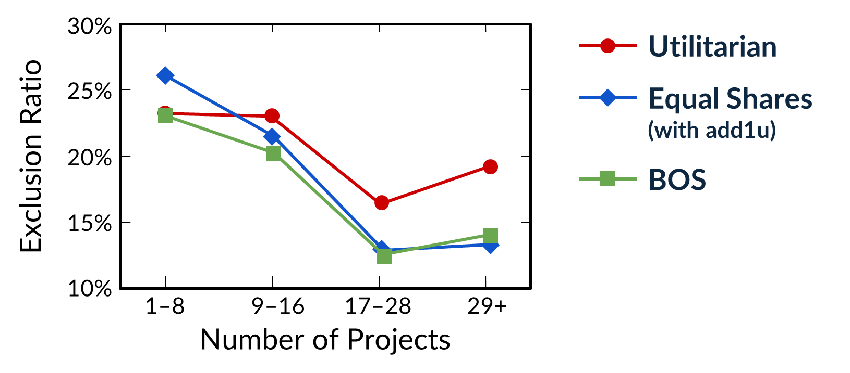
PaBuLib Data Analysis
991 instances of PB elections

Slide 72
PaBuLib Data Analysis
991 instances of PB elections
1
0.75
Inst. EJR+ Violations
0.5
out of 758 approval-based instances
0.25
0

Slide 73
PaBuLib Data Analysis
991 instances of PB elections
1
0.75
Inst. EJR+ Violations
0.5
out of 758 approval-based instances
26%
0.25
4%
0
0%
Util.
Eq. Shares
BOS

Slide 74
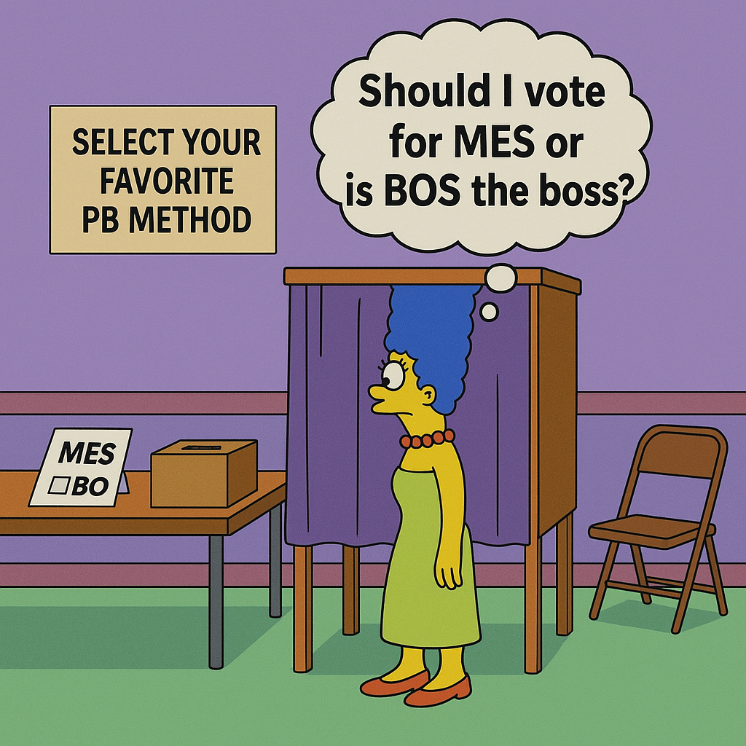

Slide 75
The present and the future

Slide 76
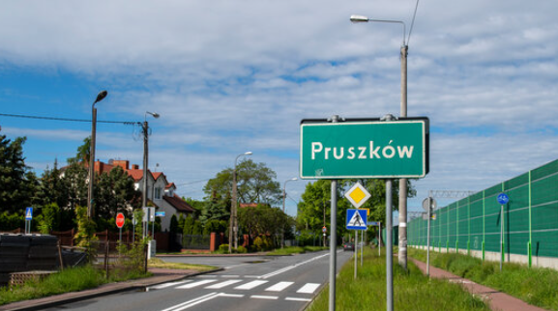
The present and the future
Cities, Organizations (Greece?)
Negative votes
Constraints: e.g. at most 1 project in an empty land
Agents’ contributions
Online PB and PB with predictions
PB beyond traditional elections (e.g. Project Catalyst, Gitcoin, Polkadot, nodes’ selection, ethical principles for LLMs etc)
Proportionality in Thumbs Up and Down Voting. S. Kraiczy, G. Papasotiropoulos, G. Pierczyński, P. Skowron
Proportionality Guarantees in Elections with Interdependent Issues
M. Brill, E. Markakis, G. Papasotiropoulos, J. Peters
Proportional Public Decisions
P. Skowron, A. Gorecki
Participatory Budgeting with Donations: The Case of Selective Voters.
E. Markakis, G. Papasotiropoulos
(working on this)
Proportional Selection in Networks. G. Papasotiropoulos, O. Skibski, P. Skowron, T. Wąs

Slide 77
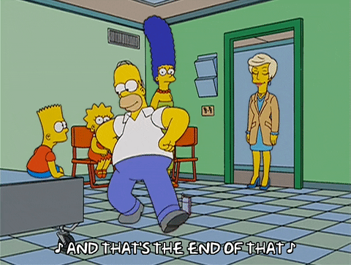
The present and the future
thanks!
Cities, Organizations (Greece?)
Negative votes
Constraints: e.g. at most 1 project in an empty land
Agents’ contributions
Online PB and PB with predictions
PB beyond traditional elections (e.g. Project Catalyst, Gitcoin, Polkadot, nodes’ selection, ethical principles for LLMs etc)
Proportionality in Thumbs Up and Down Voting. S. Kraiczy, G. Papasotiropoulos, G. Pierczyński, P. Skowron
Proportionality Guarantees in Elections with Interdependent Issues
M. Brill, E. Markakis, G. Papasotiropoulos, J. Peters
Proportional Public Decisions
P. Skowron, A. Gorecki
Participatory Budgeting with Donations: The Case of Selective Voters.
E. Markakis, G. Papasotiropoulos
(working on this)
Proportional Selection in Networks. G. Papasotiropoulos, O. Skibski, P. Skowron, T. Wąs

