Slide 1
On Improved Interval Cover Mechanisms for Crowdsourcing Markets
E. Markakis, G. Papasotiropoulos, A. Tsikiridis
Athens University of Economics and Business

Slide 2
On Improved Interval Cover Mechanisms for Crowdsourcing Markets
E. Markakis, G. Papasotiropoulos, A. Tsikiridis
Athens University of Economics and Business

Slide 3
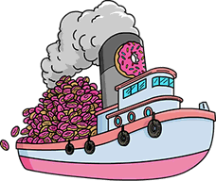
On Improved Mechanisms for Donut-Deliveries along Springfield’s river
On Improved Interval Cover Mechanisms for Crowdsourcing Markets
E. Markakis, G. Papasotiropoulos, A. Tsikiridis
Athens University of Economics and Business

Slide 4
On Improved Mechanisms for Donut-Deliveries along Springfield’s river
On Improved Interval Cover Mechanisms for Crowdsourcing Markets
Oh, please, tell me more!
E. Markakis, G. Papasotiropoulos, A. Tsikiridis
Athens University of Economics and Business

Slide 5
On Improved Mechanisms for Donut-Deliveries along Springfield’s river
On Improved Interval Cover Mechanisms for Crowdsourcing Markets
E. Markakis, G. Papasotiropoulos, A. Tsikiridis
Athens University of Economics and Business
REVERSE AUCTION
hire shipping companies
to deliver , in 1D space,
to meet covering constraints

Slide 6
locations
demand
A
B
C
D
E

Slide 7
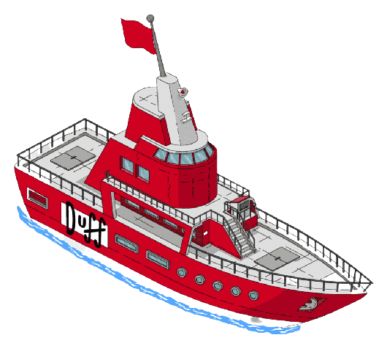
locations
demand
A
B
C
D
E

Slide 8
sellers
capacity
locations
demand
8
A
6
B
5
3
C
D
E

Slide 9
sellers
capacity
cost
locations
demand
8
10
A
6
5
B
5
4
3
3
C
D
E

Slide 10
sellers
capacity
cost
locations
demand
8
10
A
6
5
B
5
4
3
3
C
feasible solution cost
22
15
14
12
D
E

Slide 11
sellers
capacity
cost
locations
demand
8
10
A
6
5
B
5
4
3
3
C
feasible solution cost
22
15
14
12
D
E

Slide 12
sellers
capacity
cost
locations
demand
8
10
A
6
5
B
5
4
Ok, enough!
Be formal!
3
3
C
feasible solution cost
22
15
14
12
D
E

Slide 16
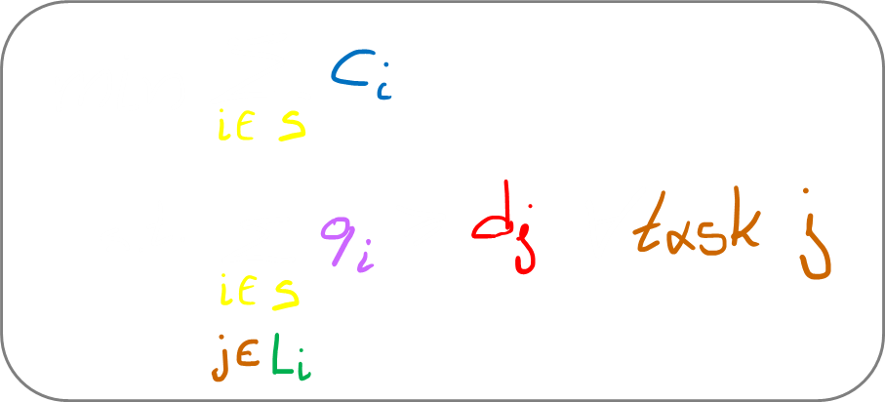

Slide 17
It looks like someone could gain more by lying about his bid…

Slide 18
It looks like someone could gain more by lying about his bid…
Unless mechanisms are truthful!

Slide 19
APPROXIMATION RATIO TRUTHFULNESS

Slide 20
APPROXIMATION RATIO TRUTHFULNESS
$$\frac{2q.max−1}{2q.min−1}$$
$$may be$$
$$arbitrarily bad$$
[Dayama et al. AAMAS’15]:

Slide 21
APPROXIMATION RATIO TRUTHFULNESS
$$\frac{2q.max−1}{2q.min−1}$$
$$may be$$
$$arbitrarily bad$$
[Dayama et al. AAMAS’15]:
[Chen et al. INFOCOM’19]:
1 task: FPTAS
MIN-KNAPSACK

Slide 22
Are these mechanisms indeed truthful?
APPROXIMATION RATIO TRUTHFULNESS
$$\frac{2q.max−1}{2q.min−1}$$
$$may be$$
$$arbitrarily bad$$
[Dayama et al. AAMAS’15]:
[Chen et al. INFOCOM’19]:
1 task: FPTAS
MIN-KNAPSACK

Slide 23
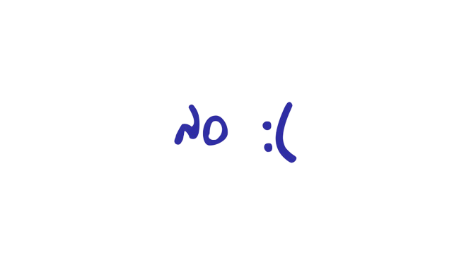
APPROXIMATION RATIO TRUTHFULNESS
$$\frac{2q.max−1}{2q.min−1}$$
$$may be$$
$$arbitrarily bad$$
[Dayama et al. AAMAS’15]:
[Chen et al. INFOCOM’19]:
1 task: FPTAS
MIN-KNAPSACK

Slide 24
APPROXIMATION RATIO TRUTHFULNESS
$$\frac{2q.max−1}{2q.min−1}$$
$$may be$$
$$arbitrarily bad$$
[Dayama et al. AAMAS’15]:
[Chen et al. INFOCOM’19]:
1 task: FPTAS
MIN-KNAPSACK
[Chakaravarthy et al. ESA’11]:
4
3
[Mondal. Asia-Pacific Journal of OR’18]:
If any of these is truthful,
then we are done!

Slide 25
APPROXIMATION RATIO TRUTHFULNESS
$$\frac{2q.max−1}{2q.min−1}$$
$$may be$$
$$arbitrarily bad$$
[Dayama et al. AAMAS’15]:
[Chen et al. INFOCOM’19]:
1 task: FPTAS
MIN-KNAPSACK
[Chakaravarthy et al. ESA’11]:
4
3
[Mondal. Asia-Pacific Journal of OR’18]:

Slide 26
APPROXIMATION RATIO TRUTHFULNESS
$$\frac{2q.max−1}{2q.min−1}$$
$$may be$$
$$arbitrarily bad$$
[Dayama et al. AAMAS’15]:
[Chen et al. INFOCOM’19]:
1 task: FPTAS
MIN-KNAPSACK
[Chakaravarthy et al. ESA’11]:
4
3
[Mondal. Asia-Pacific Journal of OR’18]:
Δ
i.
ii.
= max{number of workers willing to work on task i, i }
$$∀$$

Slide 27
APPROXIMATION RATIO TRUTHFULNESS
$$\frac{2q.max−1}{2q.min−1}$$
$$may be$$
$$arbitrarily bad$$
[Dayama et al. AAMAS’15]:
[Chen et al. INFOCOM’19]:
1 task: FPTAS
MIN-KNAPSACK
[Chakaravarthy et al. ESA’11]:
4
3
[Mondal. Asia-Pacific Journal of OR’18]:
Δ
i.
ii.
= max{number of workers willing to work on task i, i }
$$∀$$
O(1) tasks: FPTAS

Slide 28
APPROXIMATION RATIO TRUTHFULNESS
$$\frac{2q.max−1}{2q.min−1}$$
$$may be$$
$$arbitrarily bad$$
[Dayama et al. AAMAS’15]:
[Chen et al. INFOCOM’19]:
1 task: FPTAS
MIN-KNAPSACK
[Chakaravarthy et al. ESA’11]:
4
3
[Mondal. Asia-Pacific Journal of OR’18]:
Δ
i.
ii.
= max{number of workers willing to work on task i, i }
$$∀$$
O(1) tasks: FPTAS
What about presenting a sketch of your mechanisms?

Slide 29
set of workers

Slide 30
set of workers
This looks inspired by the Local-Ratio framework [Bar-Yehuda, Even]!

Slide 31
set of workers
This looks inspired by the Local-Ratio framework [Bar-Yehuda, Even]!
Not many Local-Ratio algorithms exist in the Mechanism Design literature!

Slide 32
set of workers

Slide 33
set of workers
Mechanism 1 is truthful and Δ-approximate.
Δ = max{number of workers willing to work on task i, i }
$$∀$$

Slide 34
(sketch of) Algorithm 2
[a pseudopolynomial DP algorithm for O(1) tasks]
set of workers
Mechanism 1 is truthful and Δ-approximate.
Δ = max{number of workers willing to work on task i, i }
$$∀$$

Slide 35
(sketch of) Algorithm 2
[a pseudopolynomial DP algorithm for O(1) tasks]
set of workers
Mechanism 2
convert Algorithm 2
to a polynomial-time, monotone algorithm
in the expense of a factor (1+ε)
make payments similarly to Mechanism 1
Mechanism 1 is truthful and Δ-approximate.
Δ = max{number of workers willing to work on task i, i }
$$∀$$

Slide 36
(sketch of) Algorithm 2
[a pseudopolynomial DP algorithm for O(1) tasks]
set of workers
Mechanism 2
convert Algorithm 2
to a polynomial-time, monotone algorithm
in the expense of a factor (1+ε)
make payments similarly to Mechanism 1
Mechanism 2 is a truthful FPTAS for O(1) tasks.
Mechanism 1 is truthful and Δ-approximate.
Δ = max{number of workers willing to work on task i, i }
$$∀$$

Slide 37
(sketch of) Algorithm 2
[a pseudopolynomial DP algorithm for O(1) tasks]
set of workers
Mechanism 2
convert Algorithm 2
to a polynomial-time, monotone algorithm
in the expense of a factor (1+ε)
make payments similarly to Mechanism 1
Mechanism 2 is a truthful FPTAS for O(1) tasks.
There is a paper by
[Briest, Krysta & Vocking]
suggesting such conversions.
Mechanism 1 is truthful and Δ-approximate.
Δ = max{number of workers willing to work on task i, i }
$$∀$$

Slide 38
(sketch of) Algorithm 2
[a pseudopolynomial DP algorithm for O(1) tasks]
set of workers
Mechanism 2
convert Algorithm 2
to a polynomial-time, monotone algorithm
in the expense of a factor (1+ε)
make payments similarly to Mechanism 1
Mechanism 2 is a truthful FPTAS for O(1) tasks.
Mechanism 1 is truthful and Δ-approximate.
Thanks!
Δ = max{number of workers willing to work on task i, i }
$$∀$$

Slide 39
May I?

Slide 40
Is your problem similar to Unsplittable Flow Problem?

Slide 41
restriction UFP-related result

Slide 42
restriction UFP-related result
identical contrib. easy ☺
3 distinct contrib. values hard ☹
2 distinct contrib. values ? ? ?

Slide 43
restriction UFP-related result

Slide 44
restriction UFP-related result

Slide 45
restriction UFP-related result

Slide 46
identical contrib. easy ☺
3 distinct contrib. values hard ☹
2 distinct contrib. values ? ? ?
PTAS ?
better than 3-apx ?

Slide 47
identical contrib. easy ☺
3 distinct contrib. values hard ☹
2 distinct contrib. values ? ? ?
PTAS ?
better than 3-apx ?
truthful mechanism
apx-ratio between Δ and 3 ?

Slide 48
identical contrib. easy ☺
3 distinct contrib. values hard ☹
2 distinct contrib. values ? ? ?
PTAS ?
better than 3-apx ?
truthful mechanism
apx-ratio between Δ and 3 ?
2 D

Slide 49
thanks!

