Slide 1
On the Potential and Limitations of Proxy Voting:
Delegation with Incomplete Votes
G. Amanatidis, A. Filos-Ratsikas, P. Lazos, E. Markakis, G. Papasotiropoulos,
University of Essex University of Edinburgh Input-Output Input-Output University of Warsaw
Archimedes/Athena RC Archimedes/Athena RC Input-Output
Athens University of Economics and Business

Slide 2
What exactly is meant by delegation?
On the Potential and Limitations of Proxy Voting:
Delegation with Incomplete Votes
G. Amanatidis, A. Filos-Ratsikas, P. Lazos, E. Markakis, G. Papasotiropoulos,
University of Essex University of Edinburgh Input-Output Input-Output University of Warsaw
Archimedes/Athena RC Archimedes/Athena RC Input-Output
Athens University of Economics and Business

Slide 3
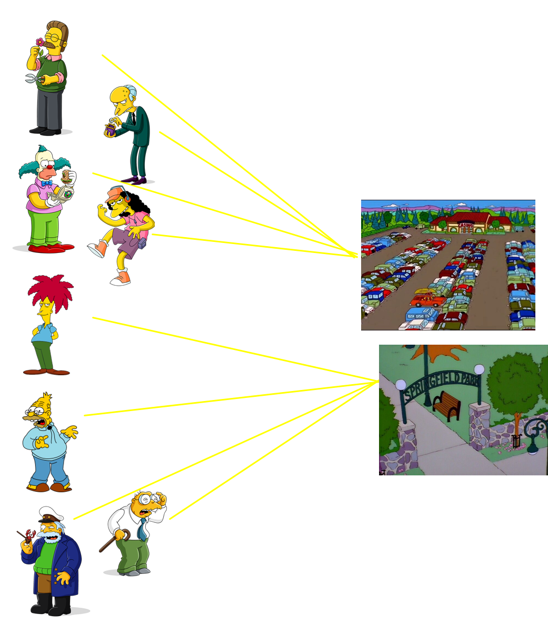
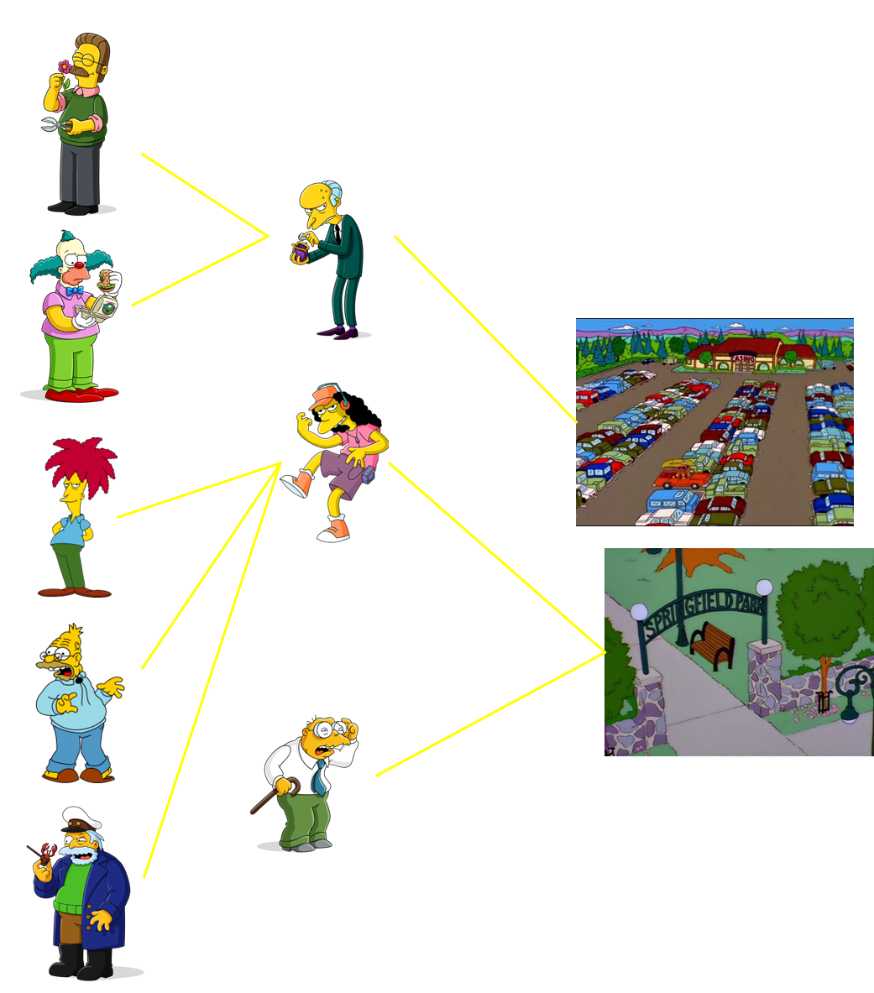
_{Direct Democracy}
_{Representative Democracy}
_{Delegative Democracy}
Anyone who feels well-informed can vote (as in direct democracy)
Voters that don’t feel at ease with voting can delegate (as in representative democracy)
Weighted voting!
Delegations are/aren’t transitive
Liquid
Democracy
Proxy Voting
Got it. And what exactly do you mean
by incomplete votes?

Slide 4
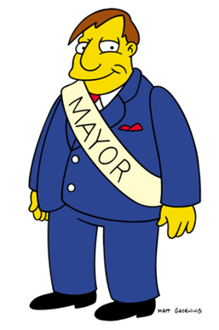
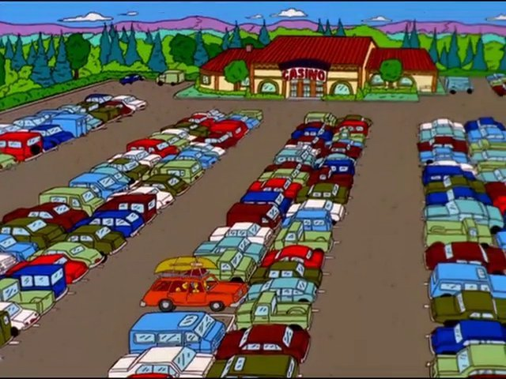

Slide 5
Let’s vote!

Slide 6
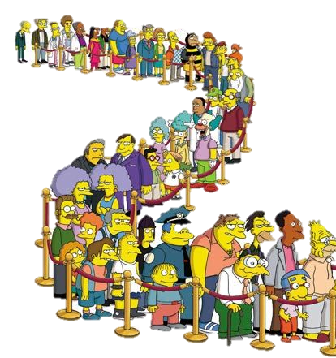
Let’s vote!

Slide 7
Overloaded!
No way I can vote
on all those proposals!

Slide 8
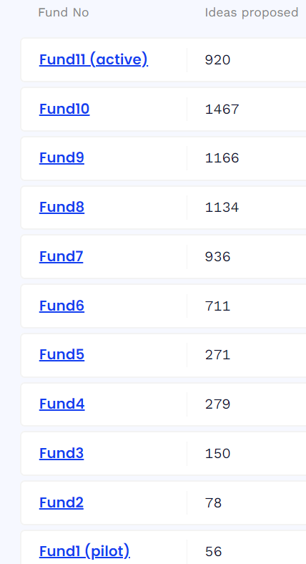
Participatory Budgeting with numerous proposals
Warsaw, Krakow
Wroclaw 2015
>200 projects
annually
>500 projects
I suspect that voting with incomplete preferences might lead to suboptimal outcomes.
Can you share an example?
delegations are allowed!

Slide 9
If we had more time to review all the projects, we'd all have approved the
last proposal.
In elections over multiple proposals
where voters have incomplete prefs
imperfect outcomes are expected!

Slide 10
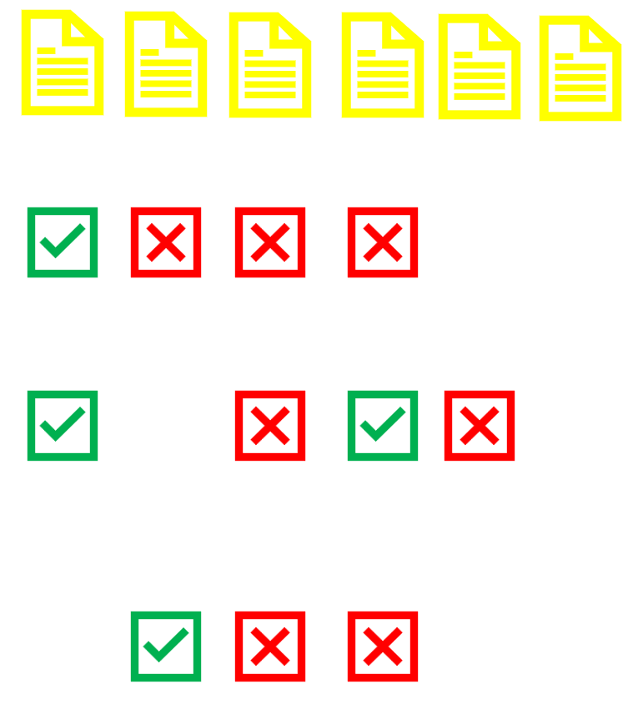
How bad could the outcome be?

Slide 11
elect proposal of approval 1
even if there is a proposal
unanimously approved
It could be
n-times worse
than the optimal!
How bad could the outcome be?

Slide 12
central question
Could delegation come to the rescue?
It could be
n-times worse
than the optimal!
How bad could the outcome be?

Slide 13
delegate
Representative
(dRep)
I do know voters’ full preferences.
I have good intentions.
If voters delegate to me, I’ll help them elect the optimal proposal

Slide 14
I agree with dRep’s ballot in 2/4 proposals. Good enough!
I’ll delegate to him!
I agree with him in 2/3 proposals. I’ll also delegate.

Slide 15
I agree with dRep’s ballot in 2/4 proposals. Good enough!
I’ll delegate to him!
So, my voting power is 3.
No other voters have cast their ballots.
The final and best proposal wins!
Looks like I’m a hero!
I agree with him in 2/3 proposals. I’ll also delegate.

Slide 16
Voters’ Preferences
Elections’ Setting
binary
single winner election
m candidate proposals,
n voters
for all issues for a subset of (intrinsic) the issues
(revealed)

Slide 17
Voters’ Preferences
Elections’ Setting
binary
single winner election
m candidate proposals,
n voters
for all issues for a subset of (intrinsic) the issues
(revealed)
Delegate Representatives (dReps)
attract voters
by advertising intended ballots
if there is a sufficient agreement
(over a certain threshold, under Hamming distance)

Slide 18
Voters’ Preferences
Elections’ Setting
binary
single winner election
m candidate proposals,
n voters
for all issues for a subset of (intrinsic) the issues
(revealed)
Who casts a ballot?
Delegate Representatives (dReps)
voters
who didn’t delegate
dReps
(weight=#voters they represent)
attract voters
by advertising intended ballots
if there is a sufficient agreement
(over a certain threshold, under Hamming distance)
proposal with maximal approvals wins

Slide 19
Voters’ Preferences
Elections’ Setting
binary
single winner election
m candidate proposals,
n voters
for all issues for a subset of (intrinsic) the issues
(revealed)
Who casts a ballot?
Delegate Representatives (dReps)
voters
who didn’t delegate
dReps
(weight=#voters they represent)
attract voters
by advertising intended ballots
if there is a sufficient agreement
(over a certain threshold, under Hamming distance)
proposal with maximal approvals wins
goal
specify advertised ballots for all dReps to achieve a ρ-apx
elect a proposal of
intrinsic score ≥ maximal intrinsic score/ρ

Slide 20
Single dRep
∃ instance: nothing better than n-apx can be achieved, with any advertised ballot, for any threshold bound.
Bounded guarantee: degrades smoothly
as the size of the largest
grows and agreement threshold decreases.
coherent set
3 apx
Majority Agreement
Same Revealed Set
set of voters with the same
revealed set of proposals
no 1.6 apx
NP-hard

Slide 21
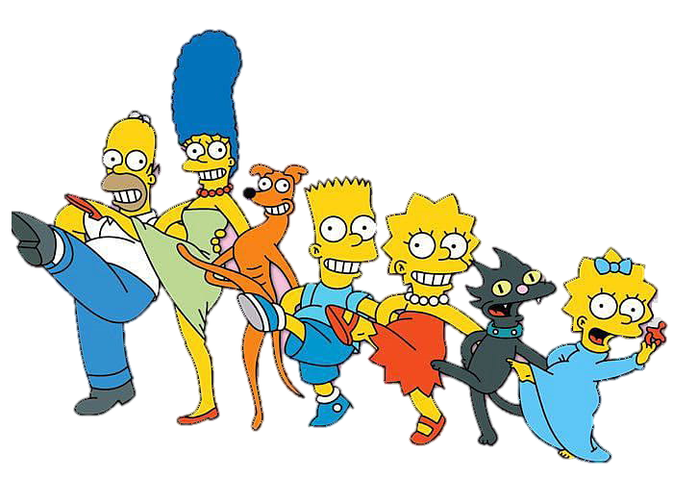
Single dRep
∃ instance: nothing better than n-apx can be achieved, with any advertised ballot, for any threshold bound.
Bounded guarantee: degrades smoothly
as the size of the largest coherent set
grows and agreement threshold decreases.
3 apx
Majority Agreement
Same Revealed Set
Two dReps
OPT
no 1.6 apx
Majority Agreement
NP-hard
Multiple dReps
Bounded guarantee: dependent on
agreement threshold,
coherence, number of dReps.
OPT
Any Agreement
Same Revealed Set

Slide 22
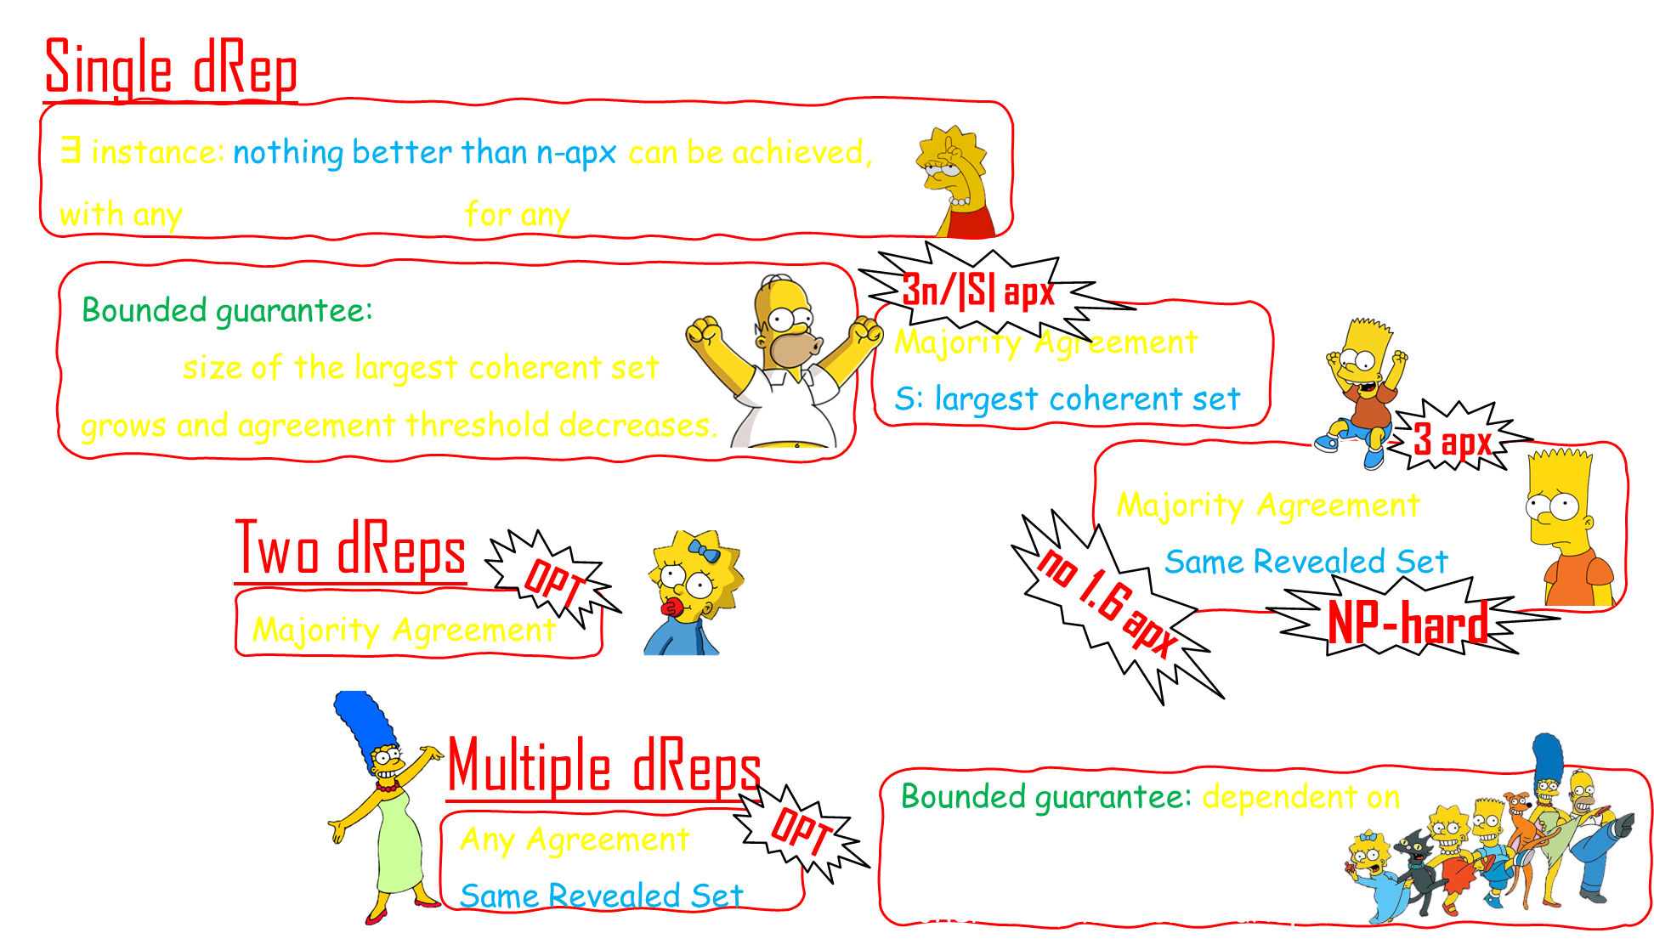
greedy heuristics for dReps’ ballots do exist
Main Observations
from Simulations
attracting many voters suffice for good apx guarantees
coherent instances are the most challenging

Slide 23
Positive Results:
limits of intractability
starting point for realistic setting
Negative Results
transfer to realistic settings
Tight Bounds
Other Rationality Models for dReps
Other Information Models for dReps
Different Rules, Frameworks, Distance Metrics

Slide 24
whakawhetai
aka Thanks!

