Slide 1
_{Adding a Temporal Dimension}
_{Towards Resolving Delegations}
_{in Liquid Democracy}
Vangelis Markakis, Giorgos Papasotiropoulos.
Athens University of Economics and Business, University of Warsaw

Slide 2
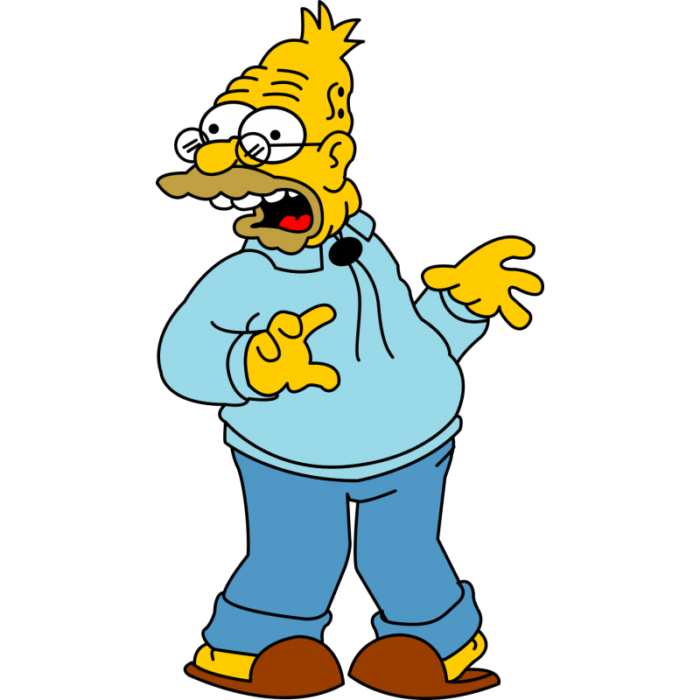
Liquid in democracy?
Sounds slippery!
What’s that even mean?
_{Adding a Temporal Dimension}
_{Towards Resolving Delegations}
_{in Liquid Democracy}
Resolving...
what now?
Temporal Voting?
Wait, do we need a time machine for this?

Slide 3
PART 1
Liquid in democracy?
Sounds slippery!
What’s that even mean?
PART 5
PART 2
Resolving...
what now?
PART 4
PART 3
Temporal Voting?
Wait, do we need a time machine for this?

Slide 4
PART 1
Liquid in democracy?
Sounds slippery!
What’s that even mean?

Slide 5
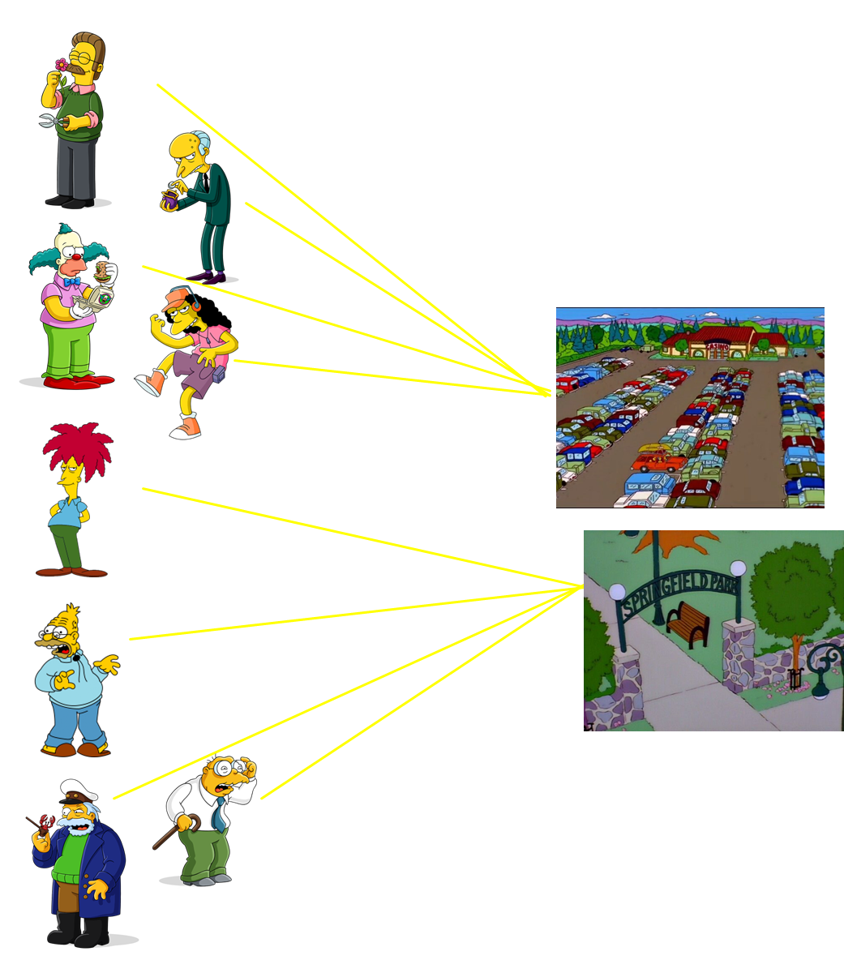
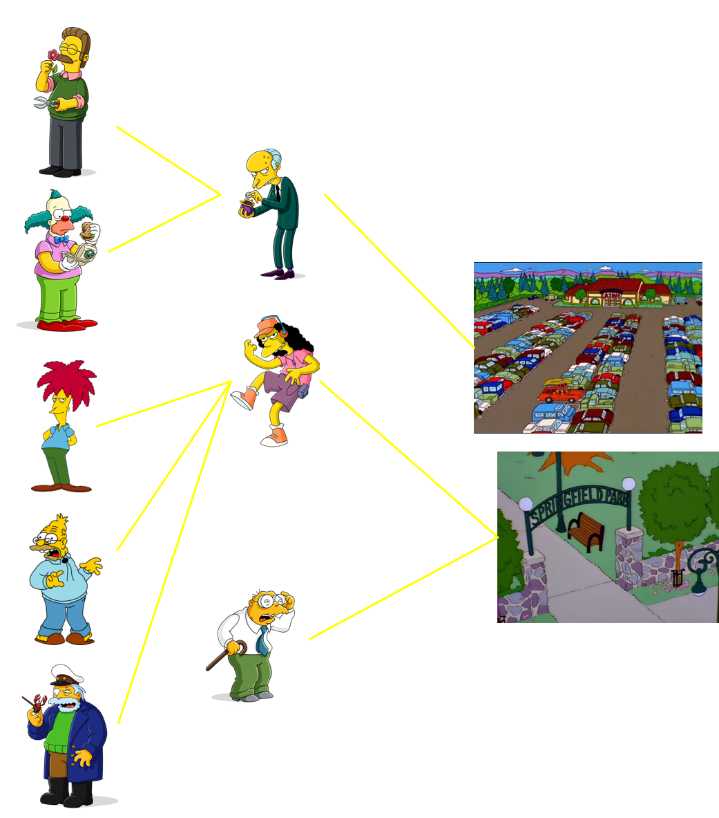
_{Direct Democracy}
_{Representative Democracy}
_{Liquid Democracy}
Anyone who feels well-informed can vote (as in direct democracy)
Voters that don’t feel at ease with voting can delegate (as in representative democracy)
Delegations are transitive
Got it!
It is like a total revolution for voting!
I’m all in!

Slide 6
PART 2
Resolving...
what now?

Slide 7
Liquid Democracy
can be
pretty effective
at times.

Slide 8
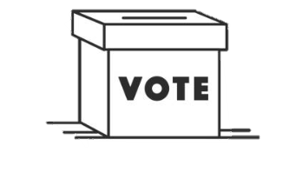
voter 2
voter 2
voter 1
voter 3
voter 3
voter 1
_{Paths to Abstainers}
_{Delegation Cycles}
voter 4
voter 4
Liquid Democracy
doesn't always come through
like we hope it would.

Slide 9
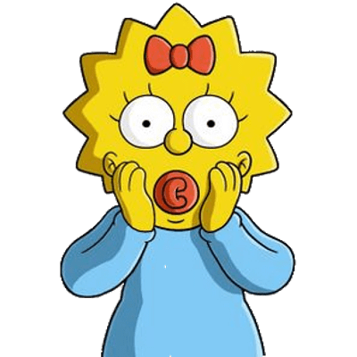
voter 2
voter 2
voter 1
voter 3
voter 3
voter 1
_{Paths to Abstainers}
_{Delegation Cycles}
voter 4
voter 4
Wow! Those problems are serious.
We've got to figure out
a way to solve them!

Slide 10
[1] M. Brill, T. Delemazure, A. George, M. Lackner, and U. Schmidt-Kraepelin. Liquid democracy with ranked delegations. (AAAI’22)
voter 2
I am fine with delegating here, there, or elsewhere, as long as it does not create a cycle or lead to an abstaining path.
The model of
multiple delegations [1].
_{How are all those}
_{delegations being resolved?}
voter 1
voter 3
CENTRALIZED
MECHANISM!
voter 4

Slide 11
What can be “temporal” in Liquid Democracy?
PART 3

Slide 12
I trust voter 2.
I'm staying consistent,
I have faith in voter 2.
voter 3
voter 3
voter 3
Guess what? I'm still sticking with voter 2.
A Good While Before
the Election Day
Shortly Before
the Election Day
_{Election Day}
Well, real-life elections work a bit differently than this.

Slide 13
Pff, too soon! I haven’t formed an opinion yet.
I've switched.
I'm going
with voter 3.
I trust voter 1.
voter 2
voter 2
voter 2
I trust voter 2.
I'm staying consistent,
I have faith in voter 2.
voter 3
voter 3
voter 3
Guess what? I'm still sticking with voter 2.
A Good While Before
the Election Day
Shortly Before
the Election Day
_{Election Day}

Slide 14
I trust voter 2.
No need to ask again;
I'm committed to voting!
Never mind, I’ll vote.
Pff, too soon! I haven’t formed an opinion yet.
I've switched.
I'm going
with voter 3.
I trust voter 1.
voter 1
voter 1
voter 1
voter 2
voter 2
voter 2
I trust voter 2.
I'm staying consistent,
I have faith in voter 2.
voter 3
voter 3
voter 3
Guess what? I'm still sticking with voter 2.
A Good While Before
the Election Day
Shortly Before
the Election Day
_{Election Day}

Slide 15
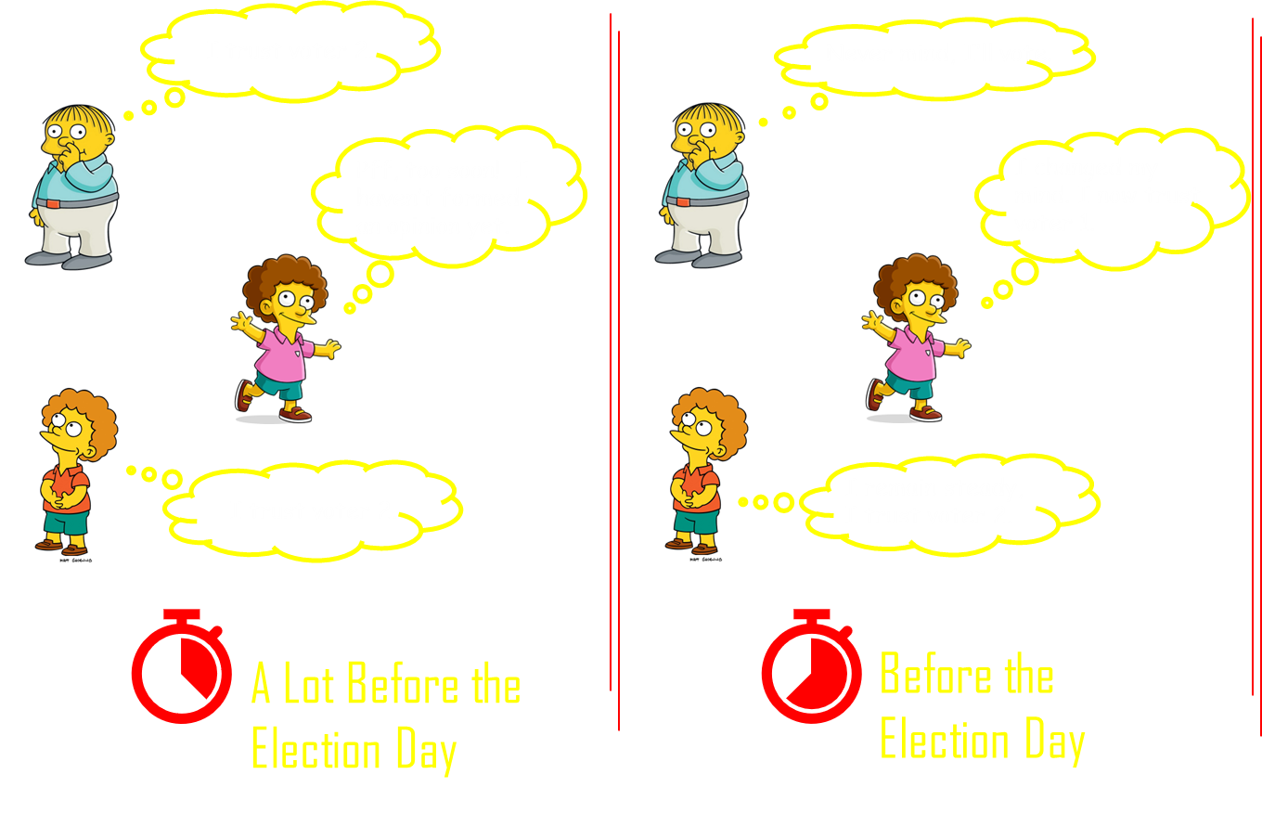
No need to ask again;
I'm committed to voting!
I've switched.
I'm going
with voter 3.
voter 1
voter 2
The norm in LD literature be like…
voter 3
Guess what? I'm still sticking with voter 2.
_{Election Day}
Let's just pretend these never happened, okay?

Slide 16
voter 1
voter 2
The norm in LD literature be like…
voter 3
_{Election Day}
Let's just pretend these never happened, okay?
Here we go again with
another delegation cycle!

Slide 17
I see where you're going with this!
You'll use the earlier preferences to hopefully find better solutions than those available on the election day!

Slide 20
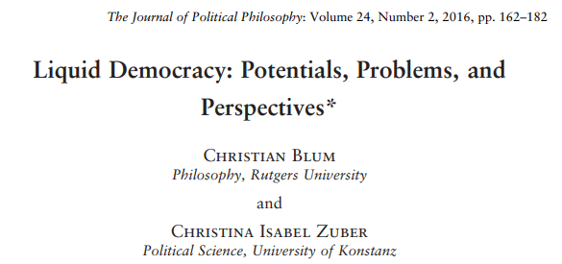
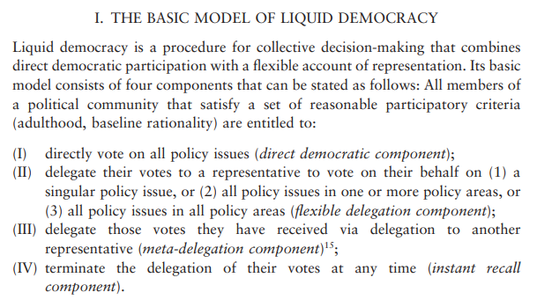
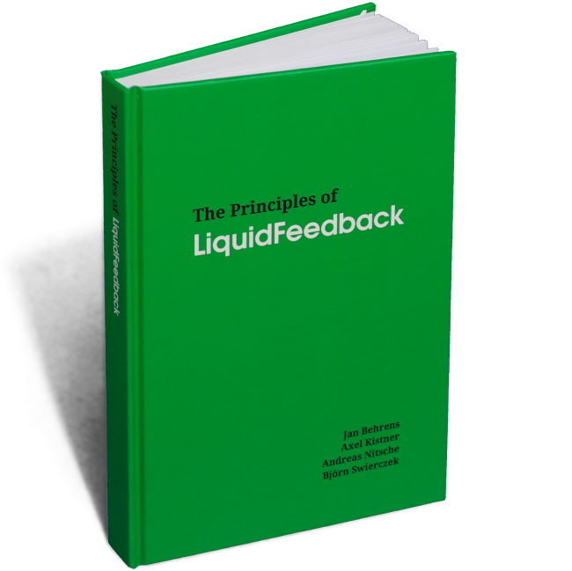
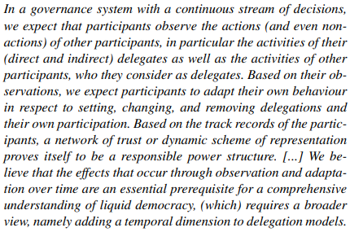

Slide 21
Don’t say more.
I'm on board with the temporal dimension.

Slide 22
PART 4
design delegation rules that are
efficient
&
time-conscious
confluent

Slide 23
design delegation rules that are
functions that map
each delegating voter
to a casting voter
via a path of trust relationships
efficient
&
time-conscious
confluent

Slide 24
design delegation rules that are
functions that map
each delegating voter
to a casting voter
via a path of trust relationships
efficient
computable in
polynomial time
&
time-conscious
confluent

Slide 25
design delegation rules that are
functions that map
each delegating voter
to a casting voter
via a path of trust relationships
efficient
computable in
polynomial time
&
time-conscious
confluent
paths respecting the ordering of the time-instants
at which a delegation is made available

Slide 26
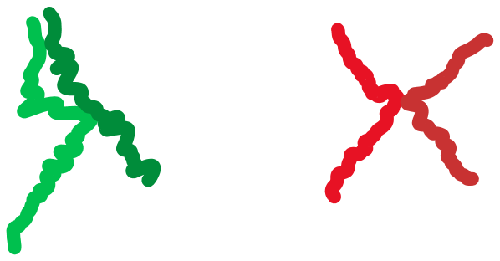
design delegation rules that are
functions that map
each delegating voter
to a casting voter
via a path of trust relationships
efficient
computable in
polynomial time
&
time-conscious
confluent
paths respecting the ordering of the time-instants
at which a delegation is made available
each voter should have at most one other
immediate representative in the outcome

Slide 27
L rounds
deliberation phase
casting phase
At each round t each voter is asked to decide between:
casting a ballot, abstaining or delegating.
(a) scores over approved voters
(b) for each approved v: for how many time-steps prior to t she approves v’s choices.
casting voters vote
delegating voters delegate
abstaining voters abstain
weighted voting rule

Slide 28
Wow, look! They're set on
utility maximization!
L rounds
deliberation phase
casting phase
At each round t each voter is asked to decide between:
casting a ballot, abstaining or delegating.
(a) scores over approved voters
(b) for each approved v: for how many time-steps prior to t she approves v’s choices.
casting voters vote
delegating voters delegate
abstaining voters abstain
weighted voting rule
Similar model to [1].
trust
horizon
parameter
[1] M. Brill, T. Delemazure, A. George, M. Lackner, and U. Schmidt-Kraepelin. Liquid democracy with ranked delegations. (AAAI’22)

Slide 29
conceptual
technical
addition of a temporal dimension
to an existing LD framework,
broadening the solution space
to bridge a research gap.
incorporation of concepts and techniques
from temporal graph theory:
a novel approach in the COMSOC field.

Slide 30
conceptual
technical
addition of a temporal dimension
to an existing LD framework,
broadening the solution space
to bridge a research gap.
incorporation of concepts and techniques
from temporal graph theory:
a novel approach in the COMSOC field.
a
graph
Temporal graph theory?
I'm curious!
Could you expand on that?

Slide 31
conceptual
technical
addition of a temporal dimension
to an existing LD framework,
broadening the solution space
to bridge a research gap.
incorporation of concepts and techniques
from temporal graph theory:
a novel approach in the COMSOC field.
a temporal
graph
Temporal graph theory?
I'm curious!
Could you expand on that?
t=1 t=2 t=3 t=4

Slide 32
design delegation rules that are
PART 5
efficient
time-conscious
confluent

Slide 33
design delegation rules that are
efficient
(even for the simplest
scoring functions and the
simplest trust horizon parameters)
time-conscious
confluent

Slide 34
design delegation rules that are
efficient
Minimum Spanning Tree
(even for the simplest
scoring functions and the
simplest trust horizon parameters)
time-conscious
confluent

Slide 35
design delegation rules that are
efficient
Temporal Shortest Path
(even for a single
delegating voter)
Minimum Spanning Tree
(even for the simplest
scoring functions and the
simplest trust horizon parameters)
(for the simplest trust horizon parameter)
time-conscious
confluent

Slide 36
design delegation rules that are
efficient
Temporal Shortest Path
(even for a single
delegating voter)
Minimum Spanning Tree
(even for the simplest
scoring functions and the
simplest trust horizon parameters)
(for the simplest trust horizon parameter)
time-conscious
confluent
(exponential only in n)
(in time exponential in Δ, Δ:= number of delegating voters,
(brute force in time exponential in n and exponential in lifespan of deliberation phase L)
for the simplest trust horizon parameter)
Directed (static) Minimum Steiner Tree

Slide 37
design delegation rules that are
efficient
Temporal Shortest Path
(even for a single
delegating voter)
Minimum Spanning Tree
(even for the simplest
scoring functions and the
simplest trust horizon parameters)
(for the simplest trust horizon parameter)
time-conscious
confluent
(exponential only in n)
(in time exponential in Δ, Δ:= number of delegating voters,
(brute force in time exponential in n and exponential in lifespan of deliberation phase L)
for the simplest trust horizon parameter)
Directed (static) Minimum Steiner Tree
Thanks! Bye!

